Slide 1


In-Patient Antibiotic Exposure Promotes SARS-CoV-2 Persistence in the GI Tract in COVID-19 Admitted Patients
Ashok Kumar Sharma Ph.D.
Postdoctoral Scientist
Devkota and Casero Lab
@ashoks773

Slide 2
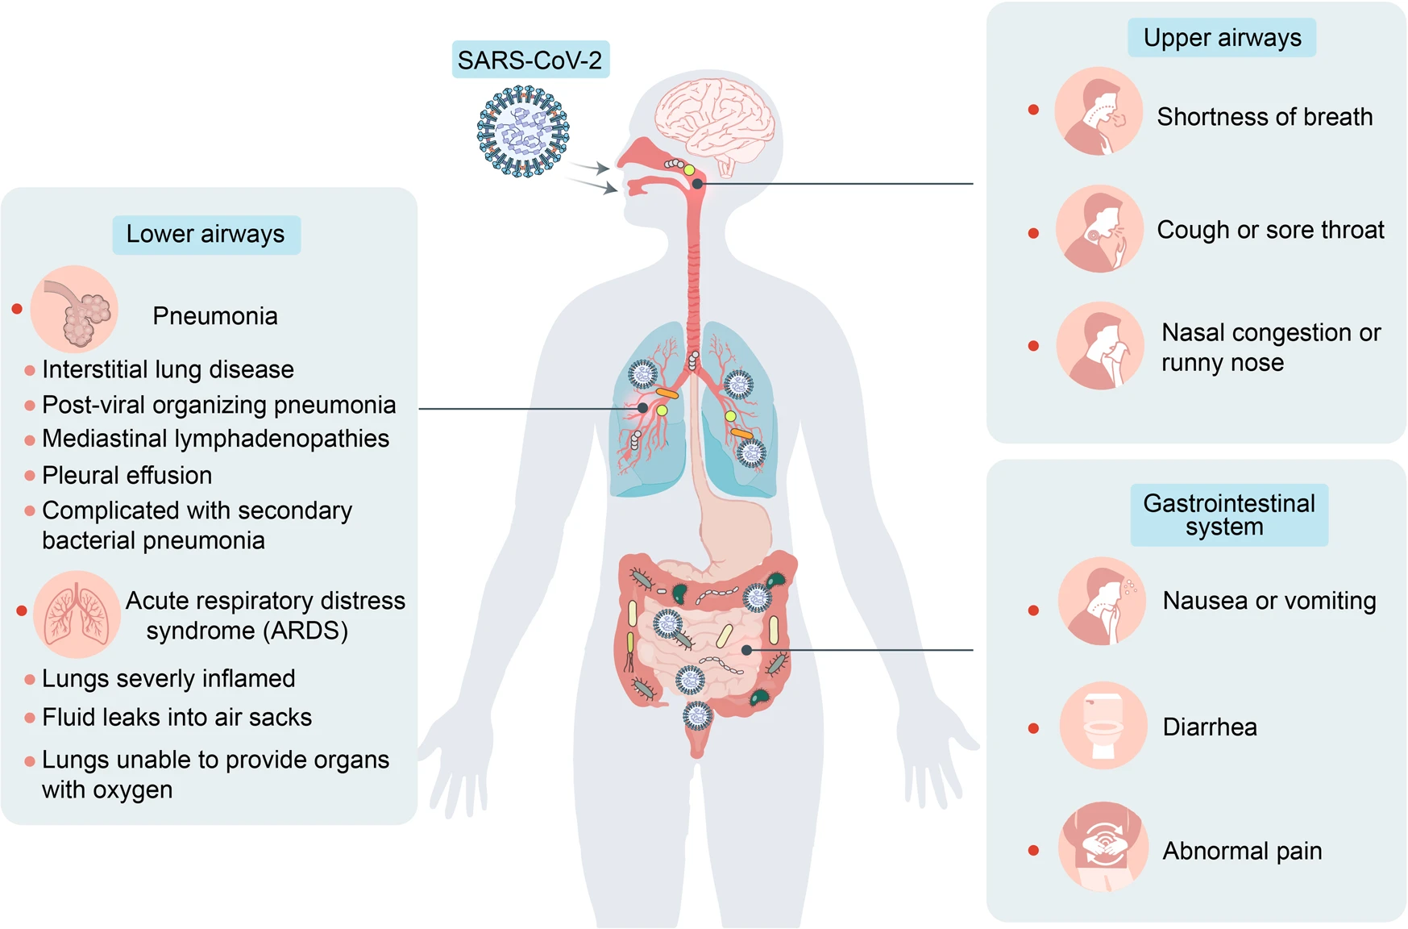
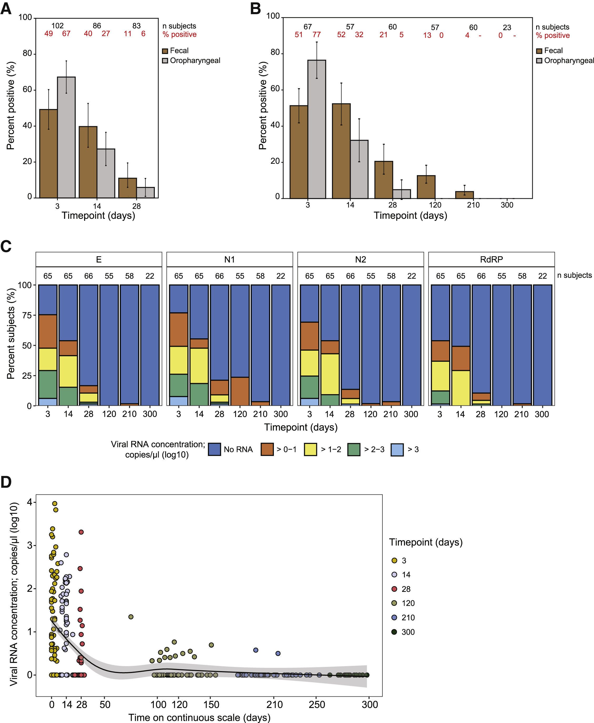
Background: COVID-19 associated respiratory and gastrointestinal symptoms and longer viral RNA positivity rates in fecal samples
At Cedars-Sinai, ~2/3 of patients admitted for COVID-19 are placed on 2-8 antibiotics
Wang et al. 2022
Natarajan et al. 2022

Slide 3
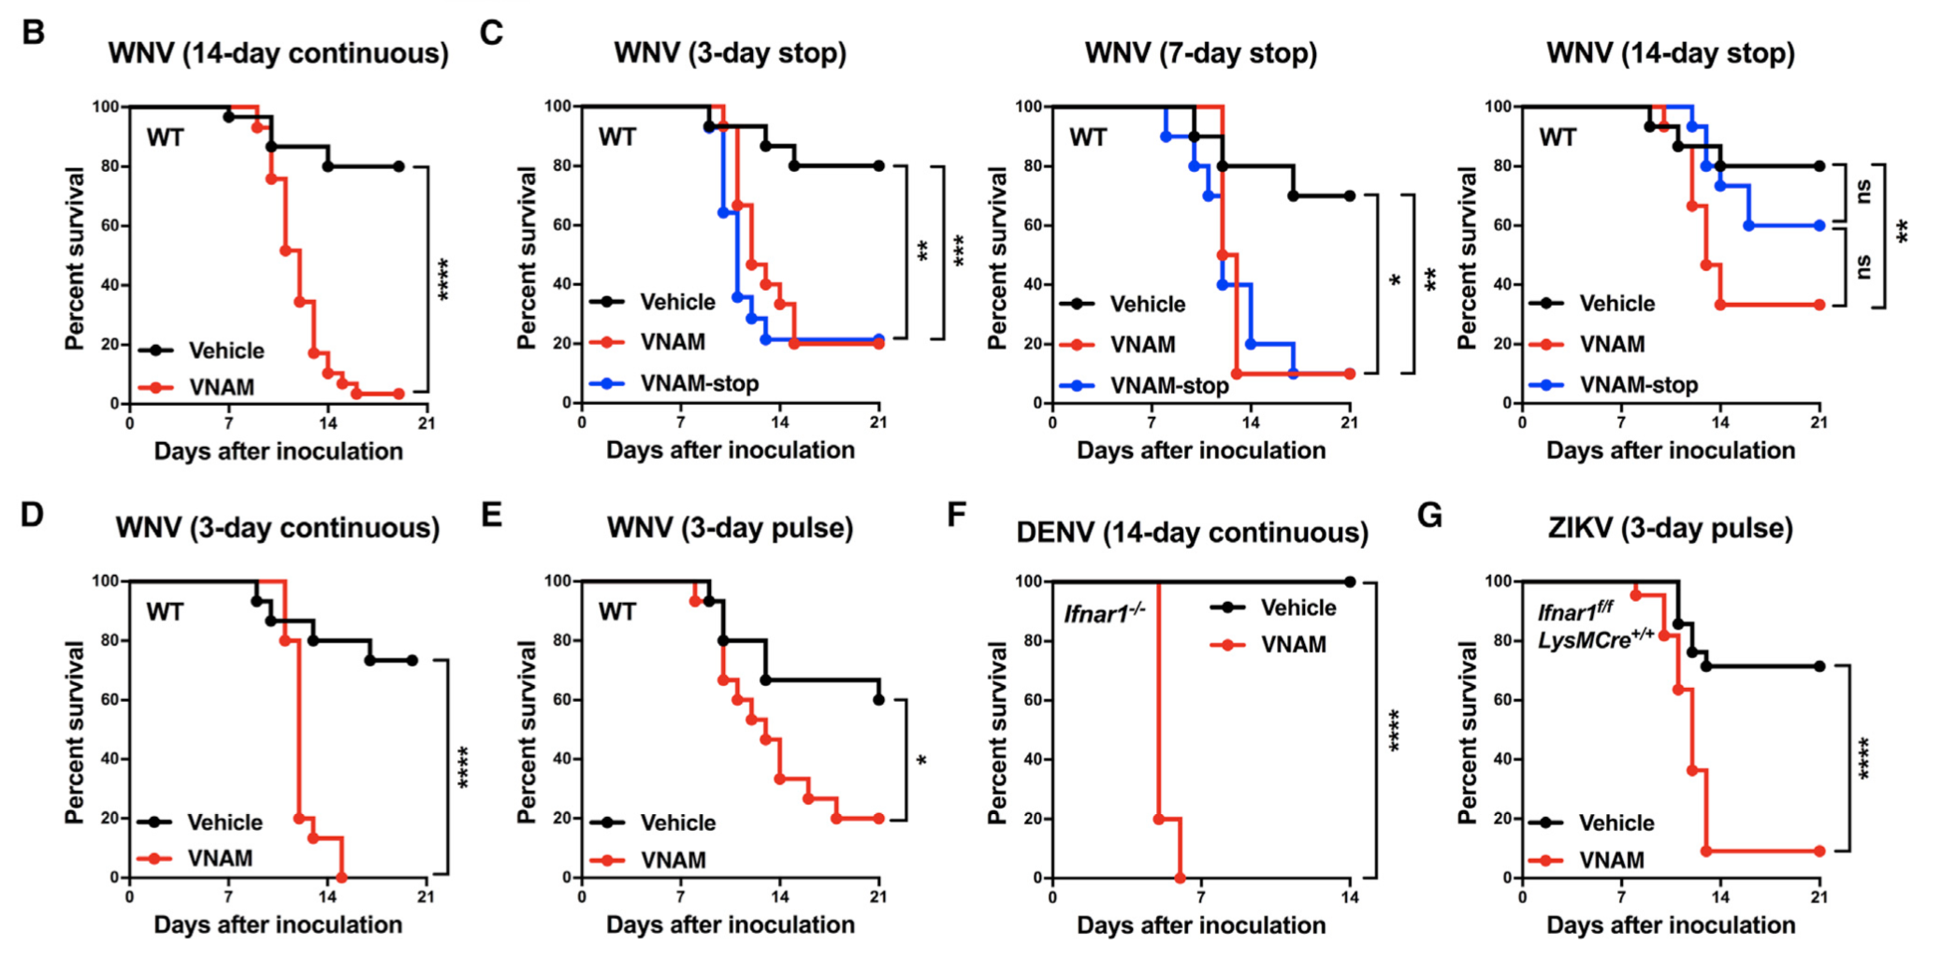
Mortality from flavivirus infection is increased in antibiotic treated mice
WNV= West Nile
DENV= Dengue
ZIKV=Zika
Thackrey et al, Cell Reports 2018

Slide 4
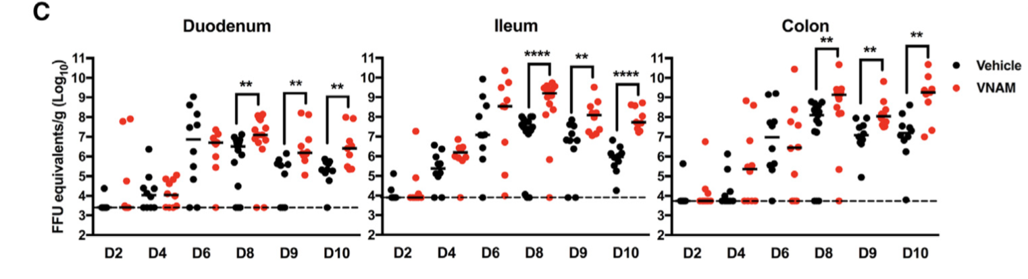
Antibiotics promoted flavivirus persistence in GI tract
Thackrey et al, Cell Reports 2018

Slide 5
Hypothesis
Antibiotic exposure significantly depletes the bacterial gut microbiota thus disturbing stable communities and impairing colonization resistance, therefore facilitating SARS-COV-2 persistence in the GI tract.

Slide 6
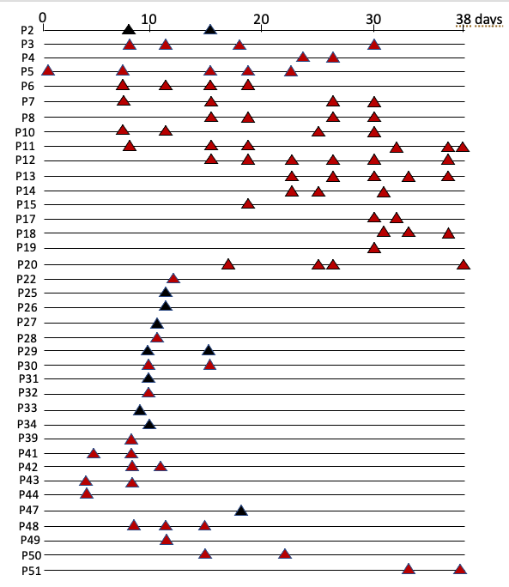
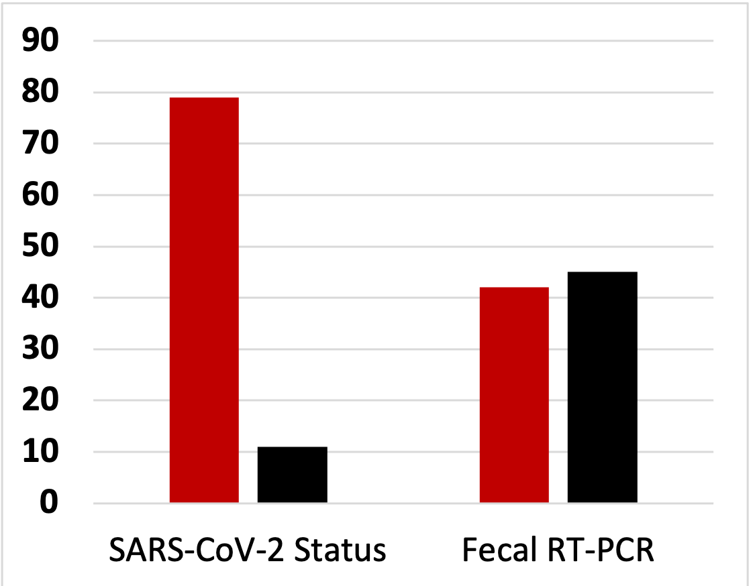
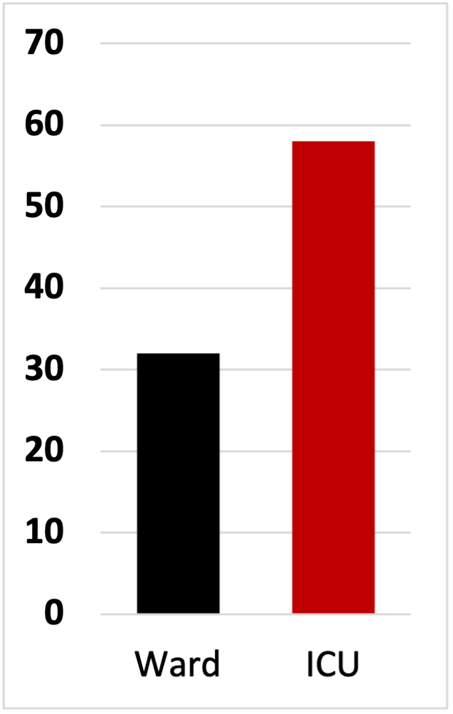
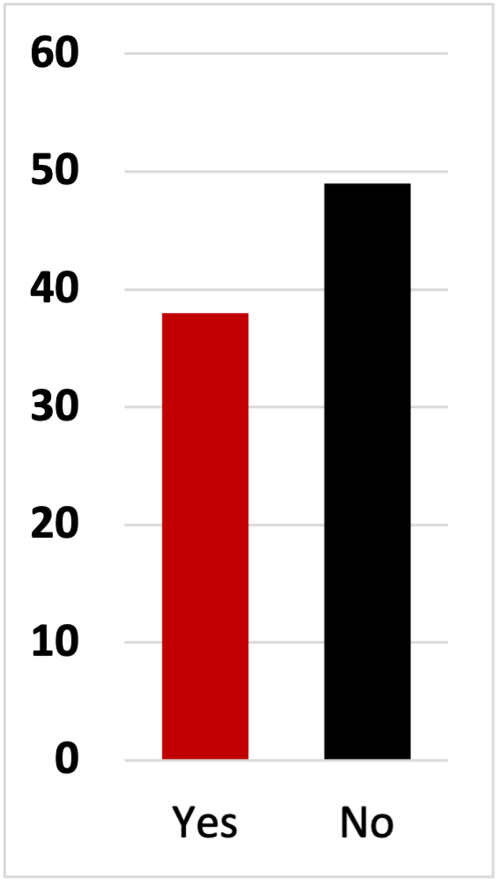
Patient population
Positive
Negative
Sample distribution from total 38 patients (29 Positive and 9 Negative) based on different variables
SARS-CoV2 Status
Severity
Abx status
Number of samples

Slide 7
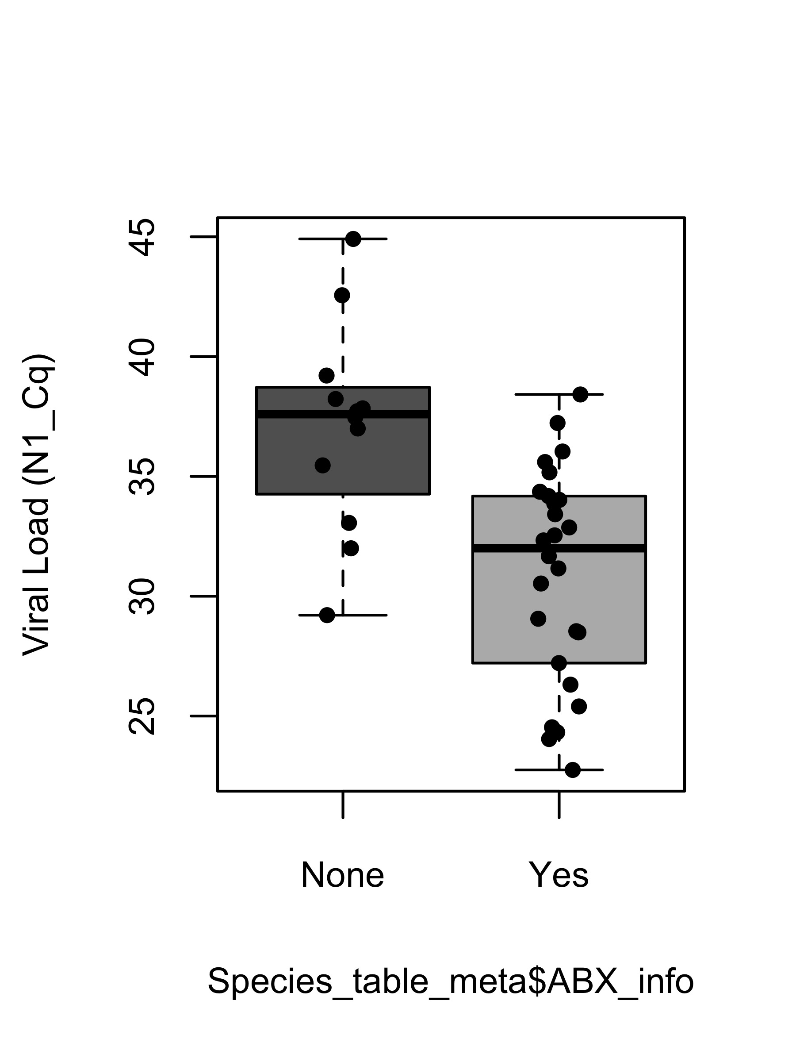
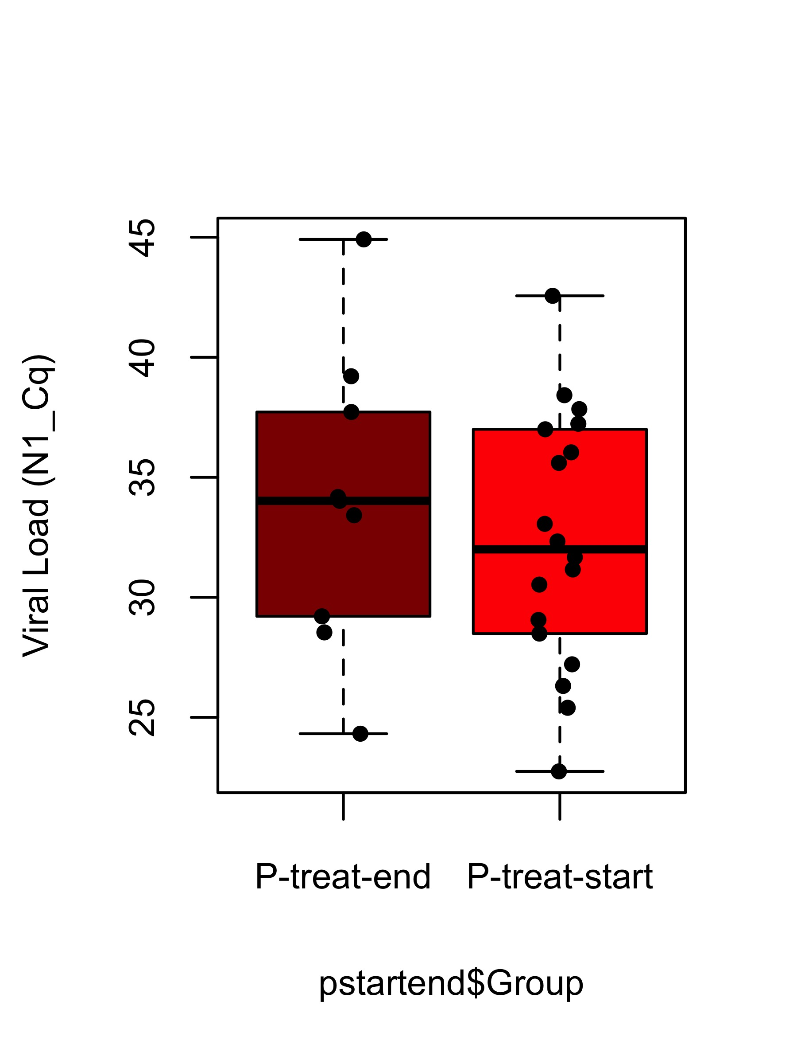
Viral load time course
Low viral load
Abx status
Time course
*
High viral load
Last collection
First collection

Slide 8
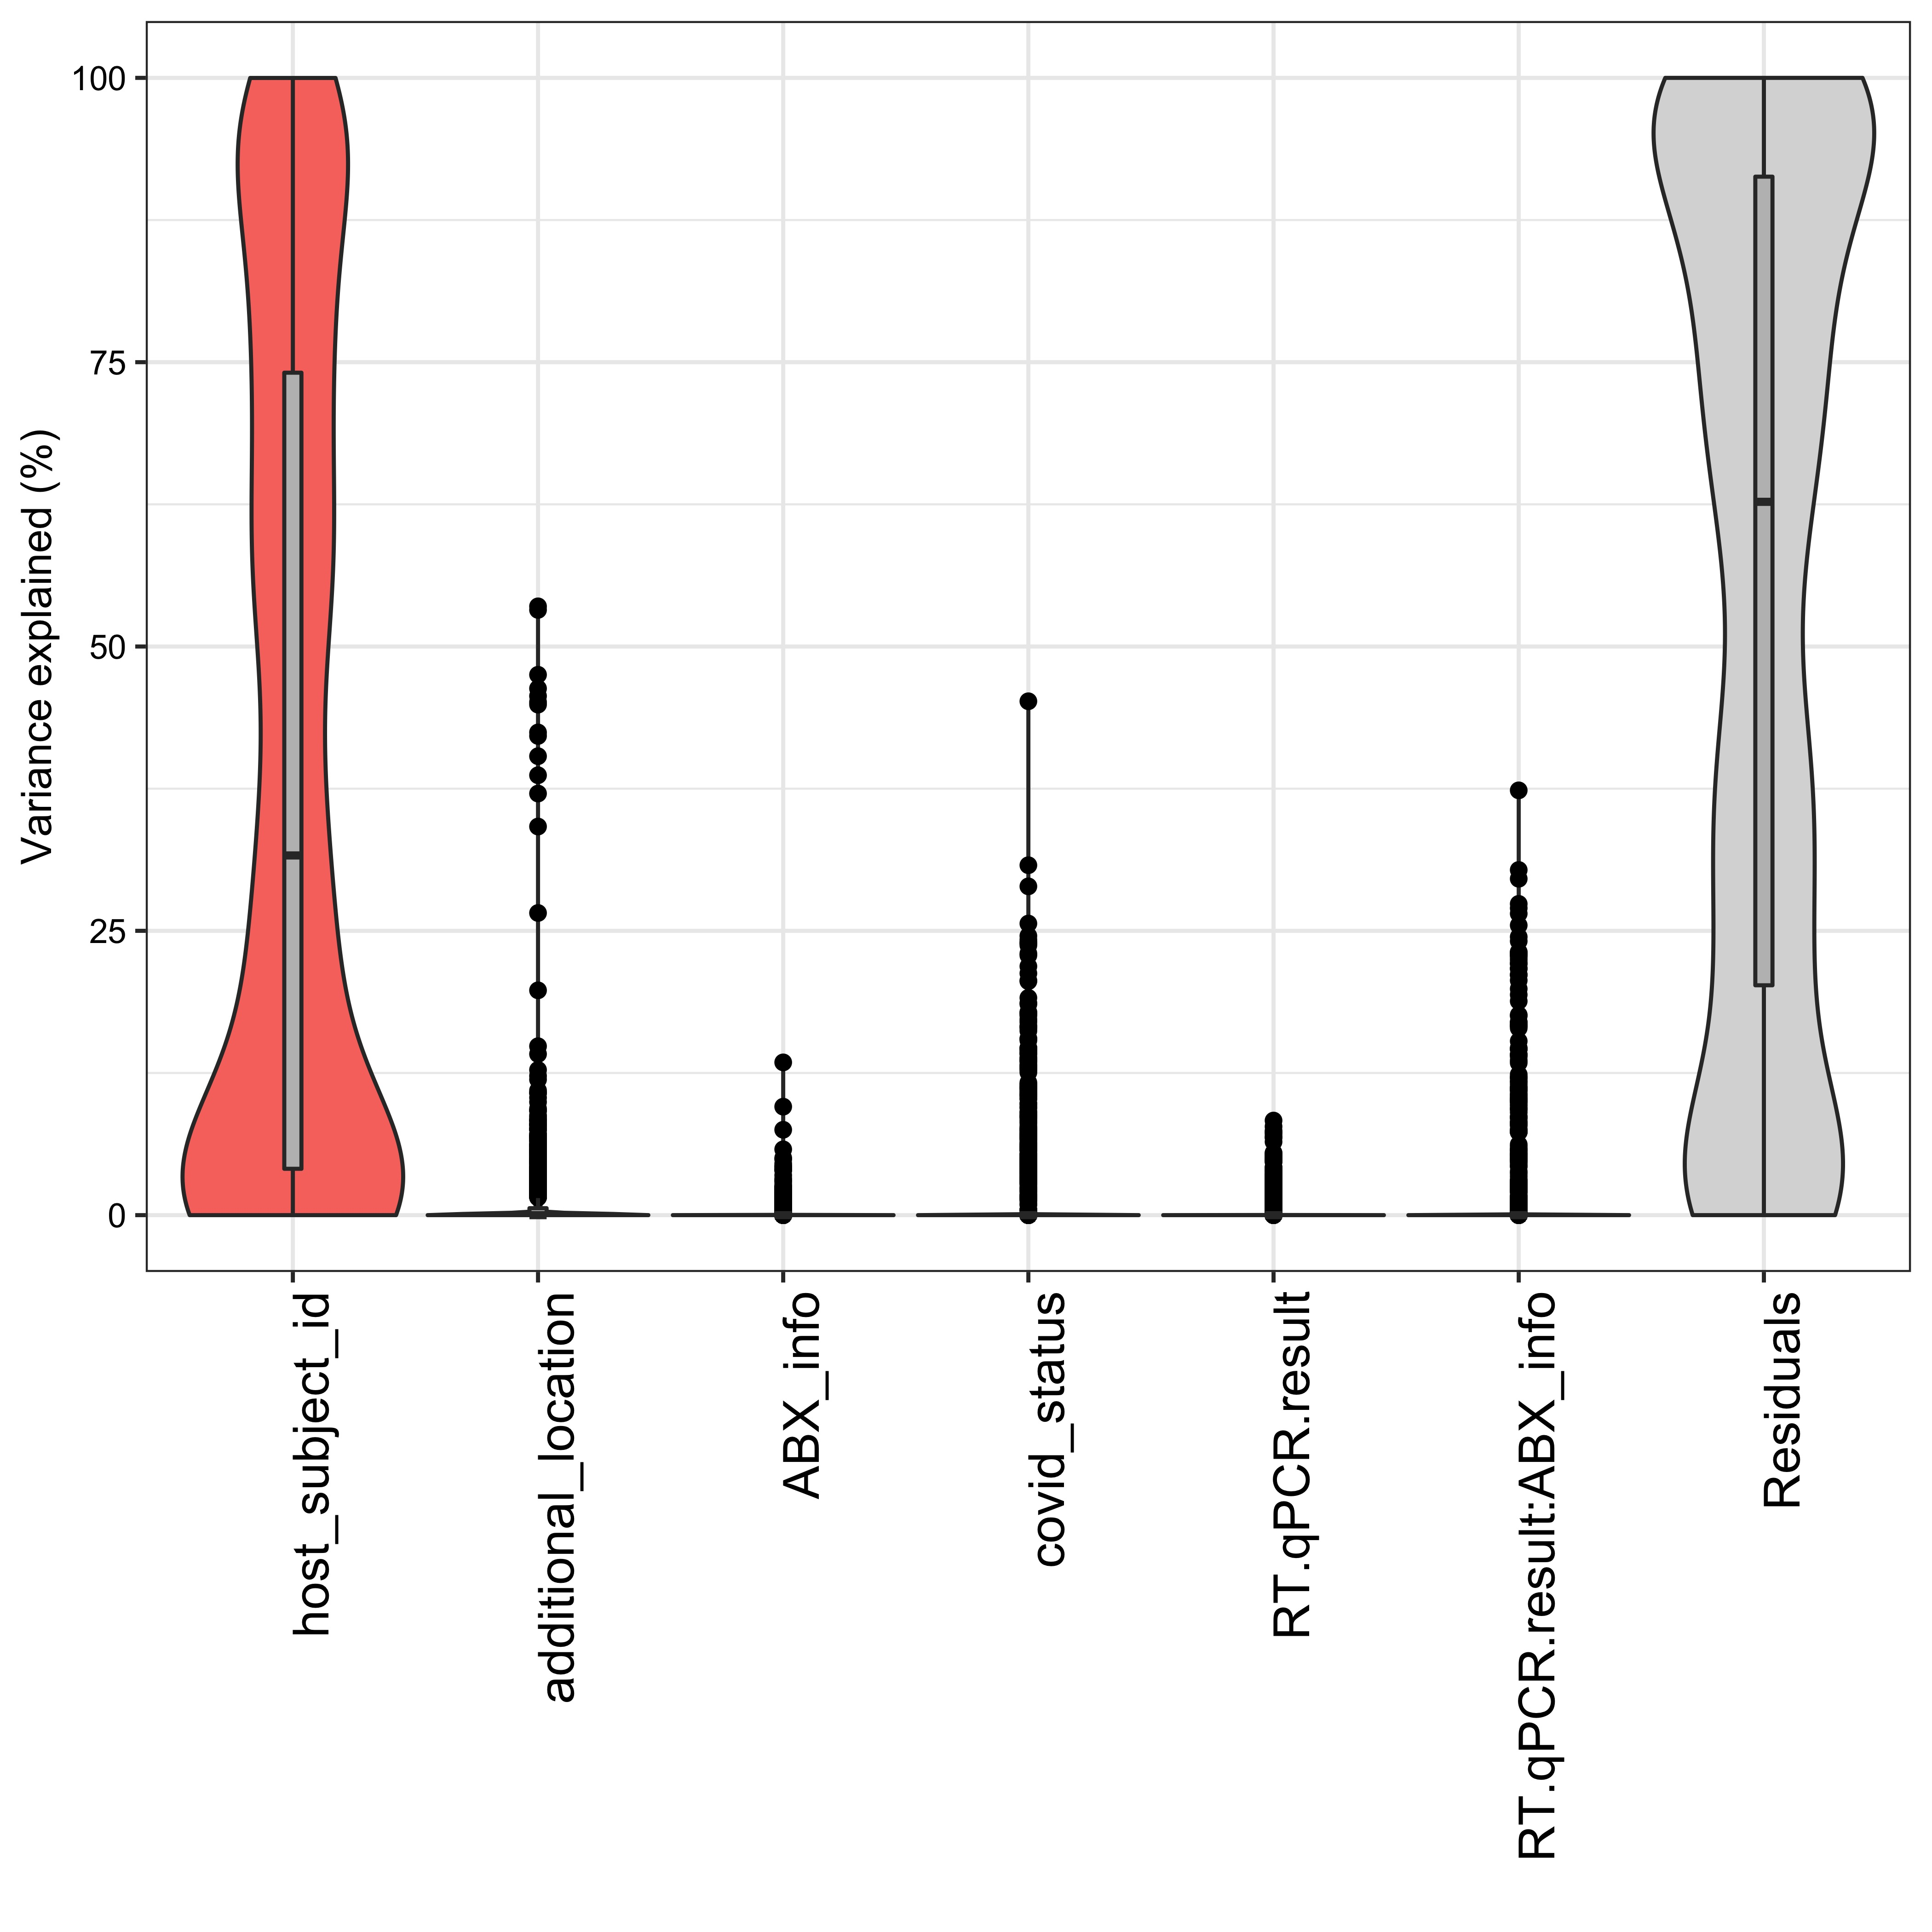
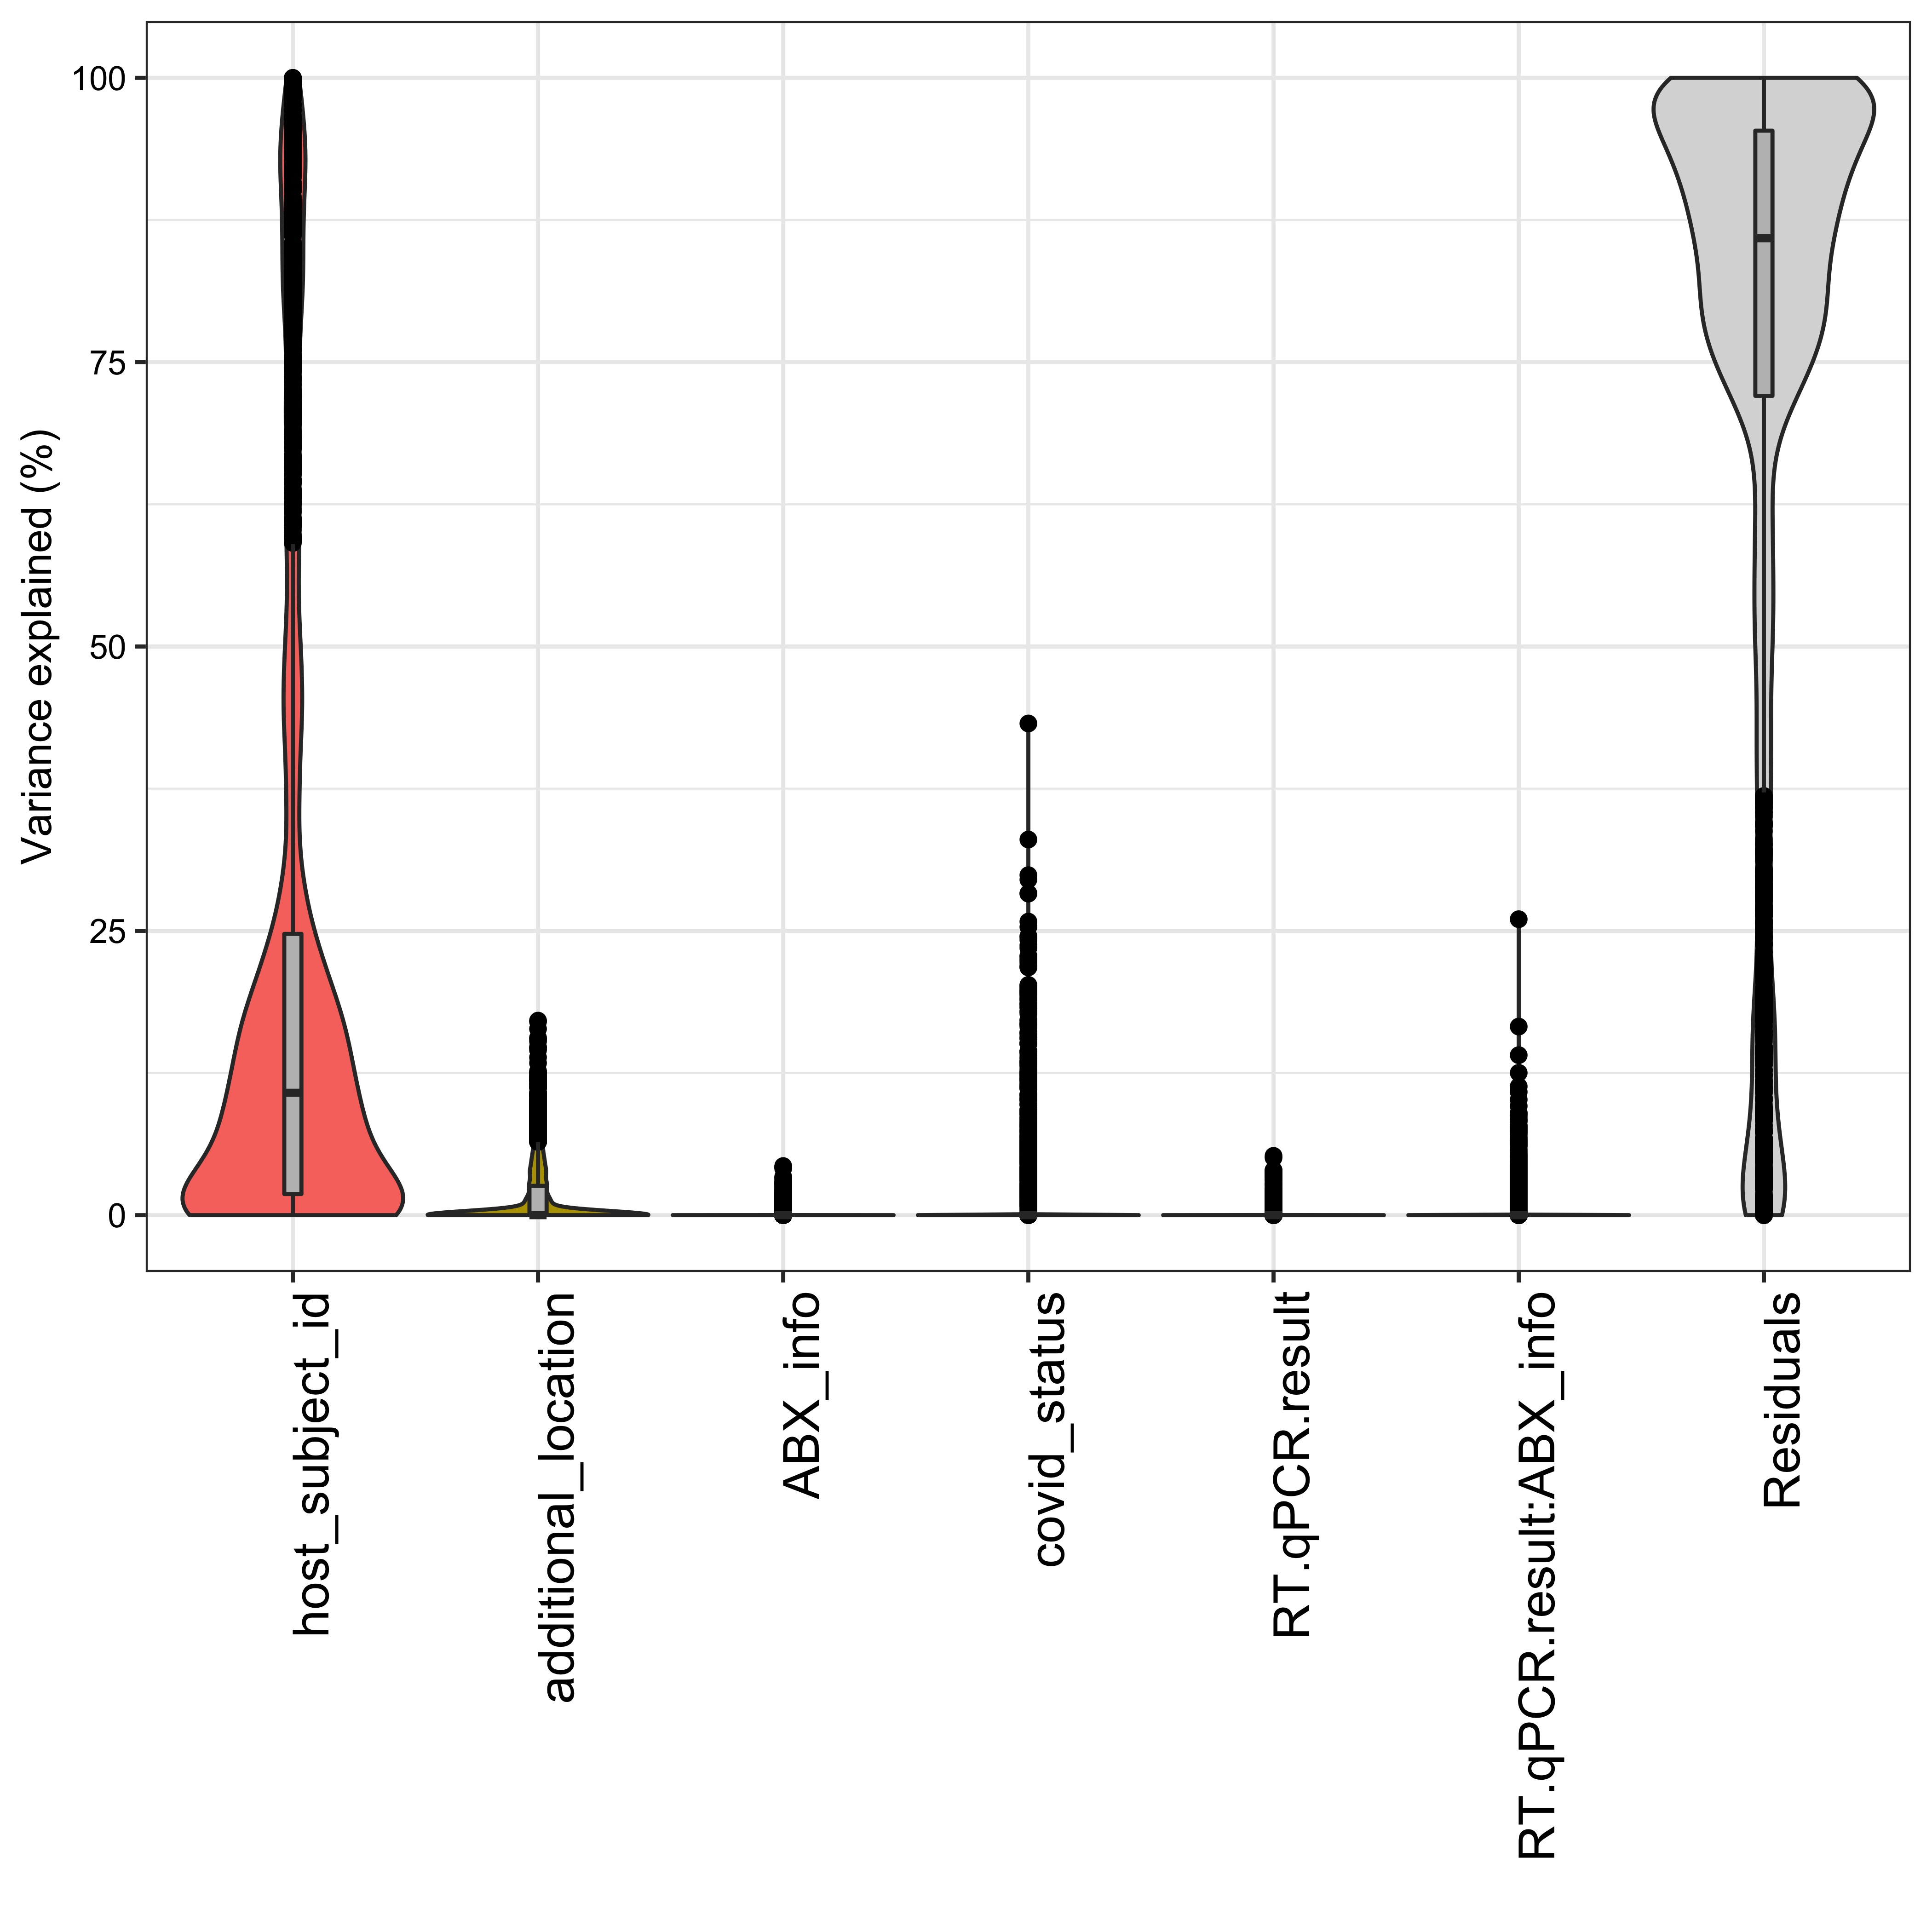
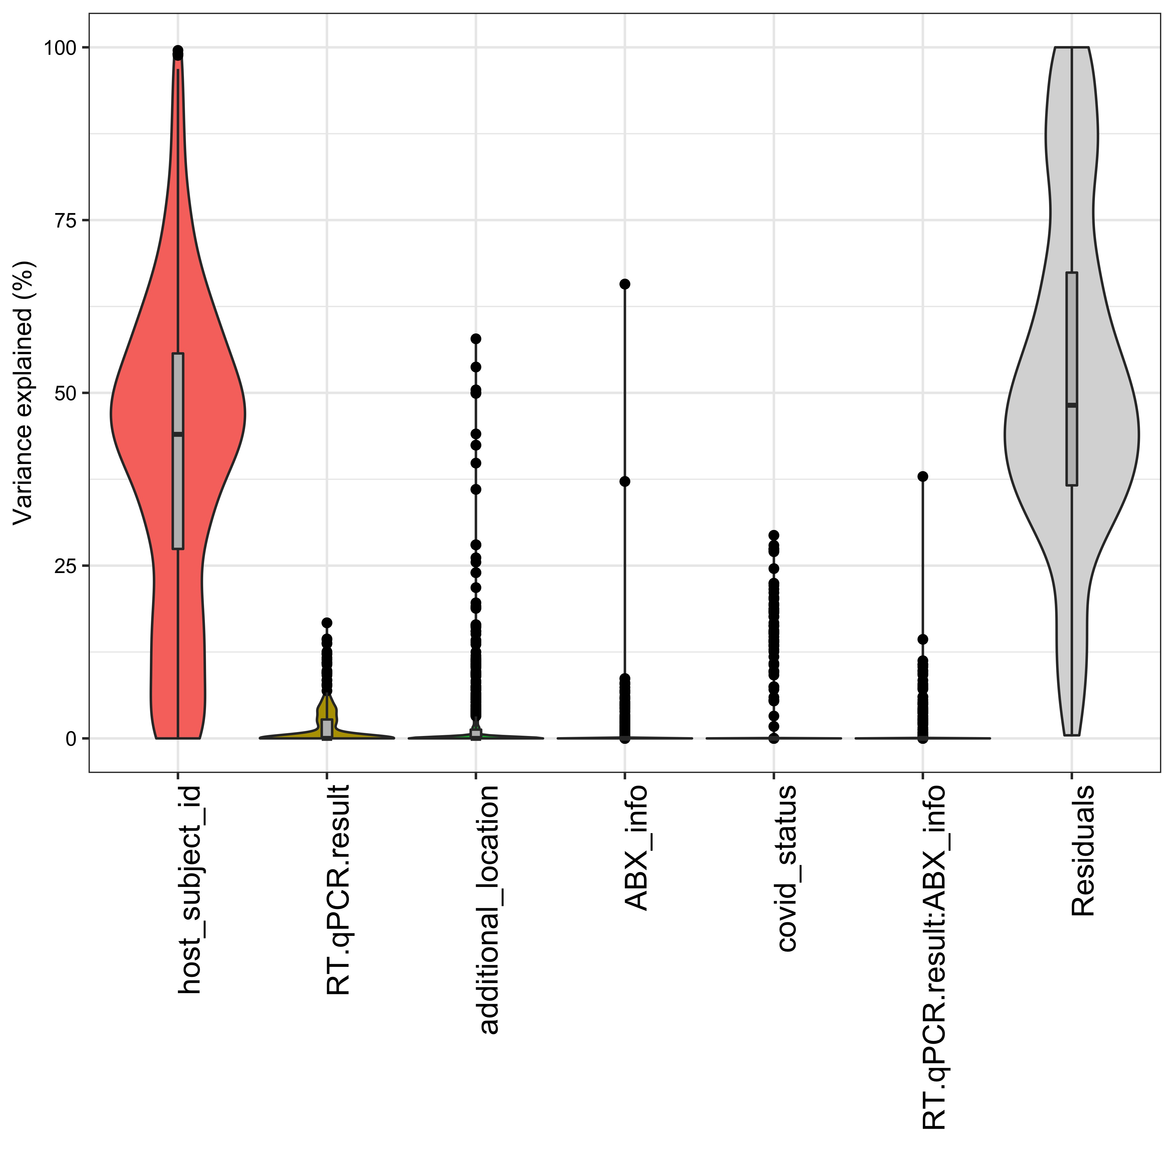
SARS-CoV-2 status, severity, and antibiotic status contribute to the explained variance based on microbial and metabolic features
Taxa abundances
Metabolite intensities
Pathway abundances
Variance explained (%)

Slide 9
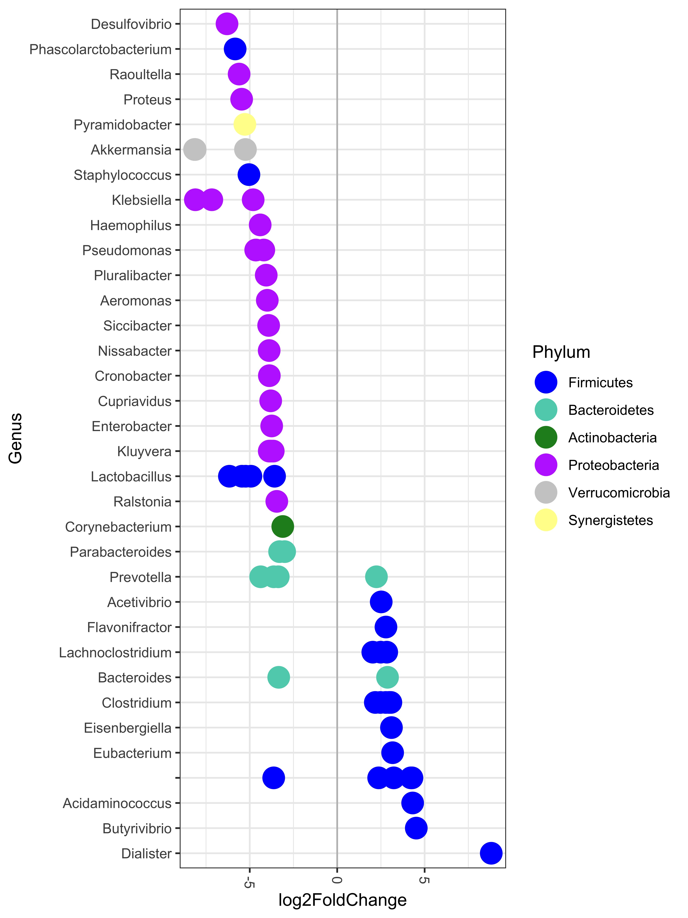
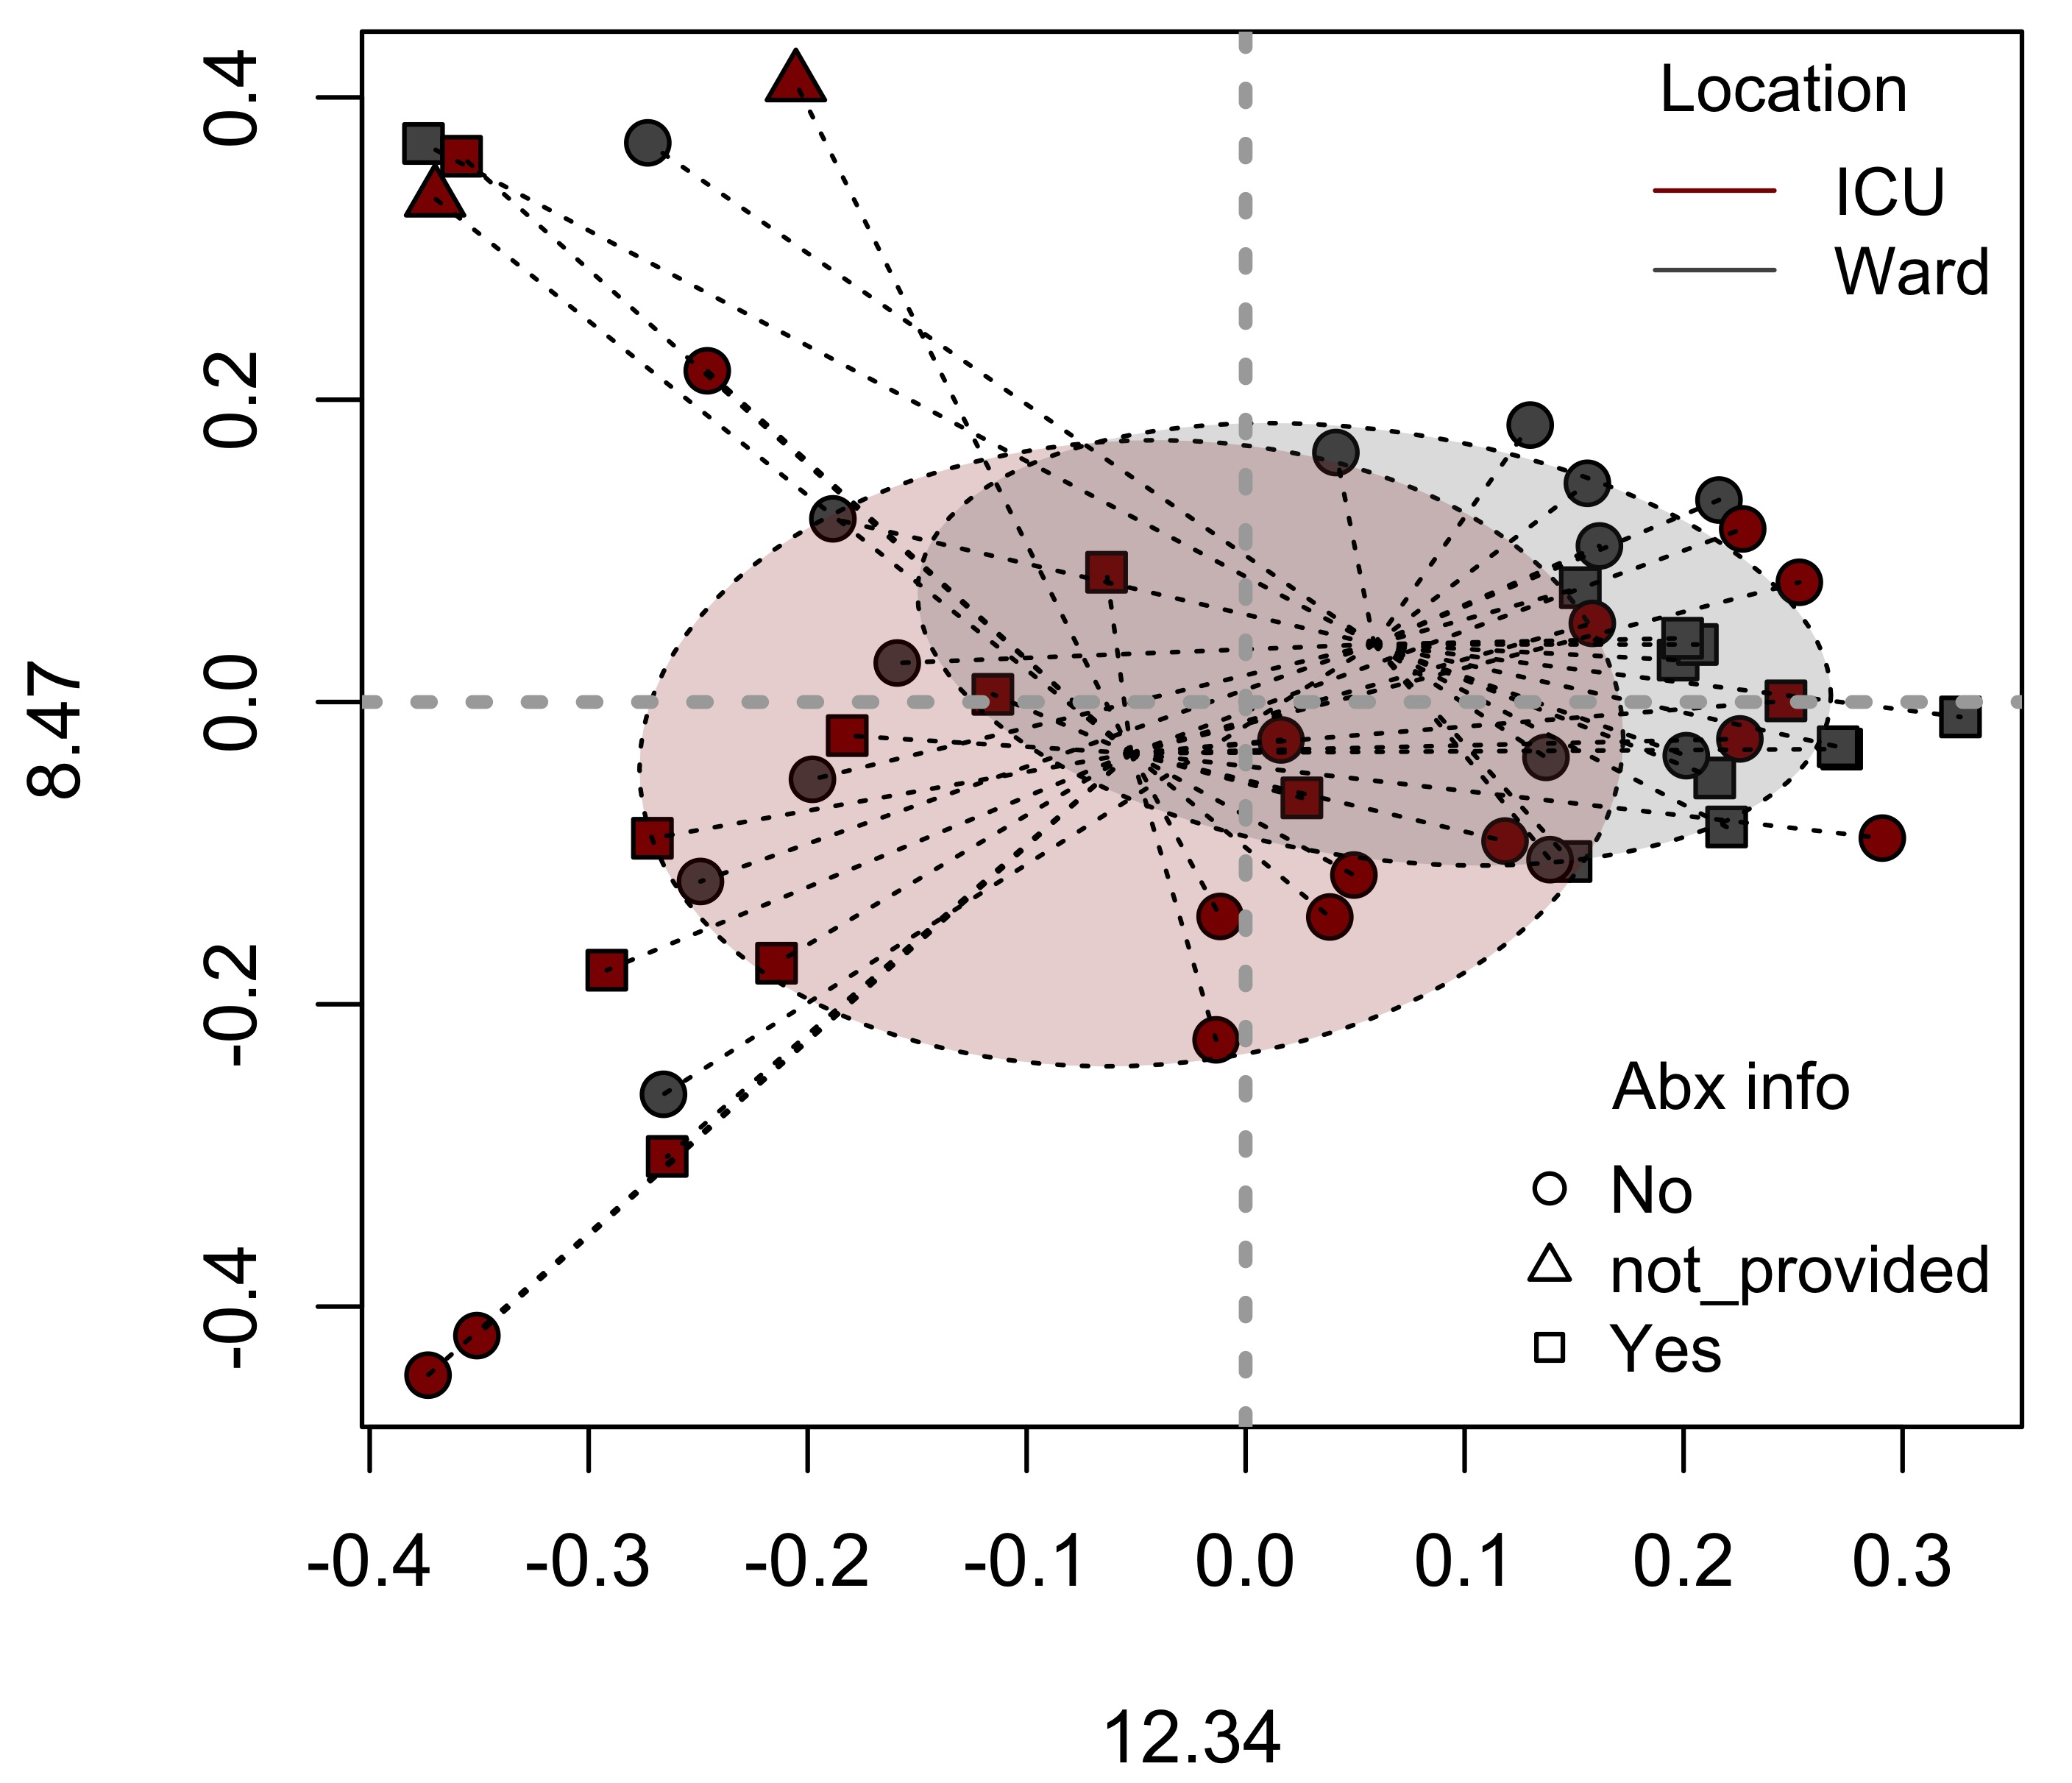
Microbiome composition differs based on COVID-19 severity
ICU
Ward
Bloom of Proteobacteria in ICU patients
Enrichment of opportunistic Desulfovibrio in patients admitted to ICU
Butyrate producers (SCFAs in general) were mostly enriched in less severe patients or at the start of the treatment
PCo2 -
PCo1 -

Slide 10
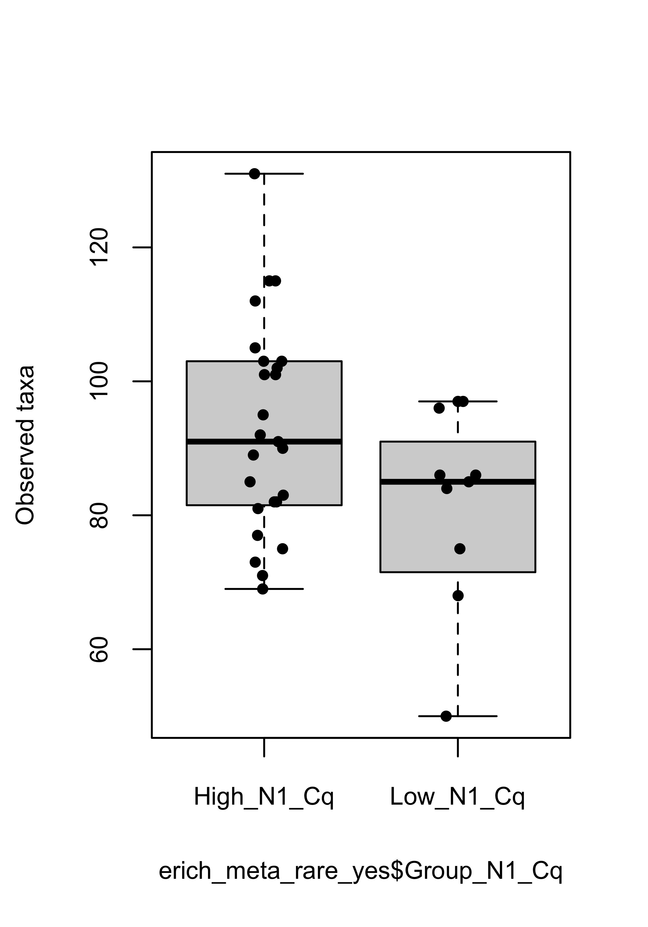
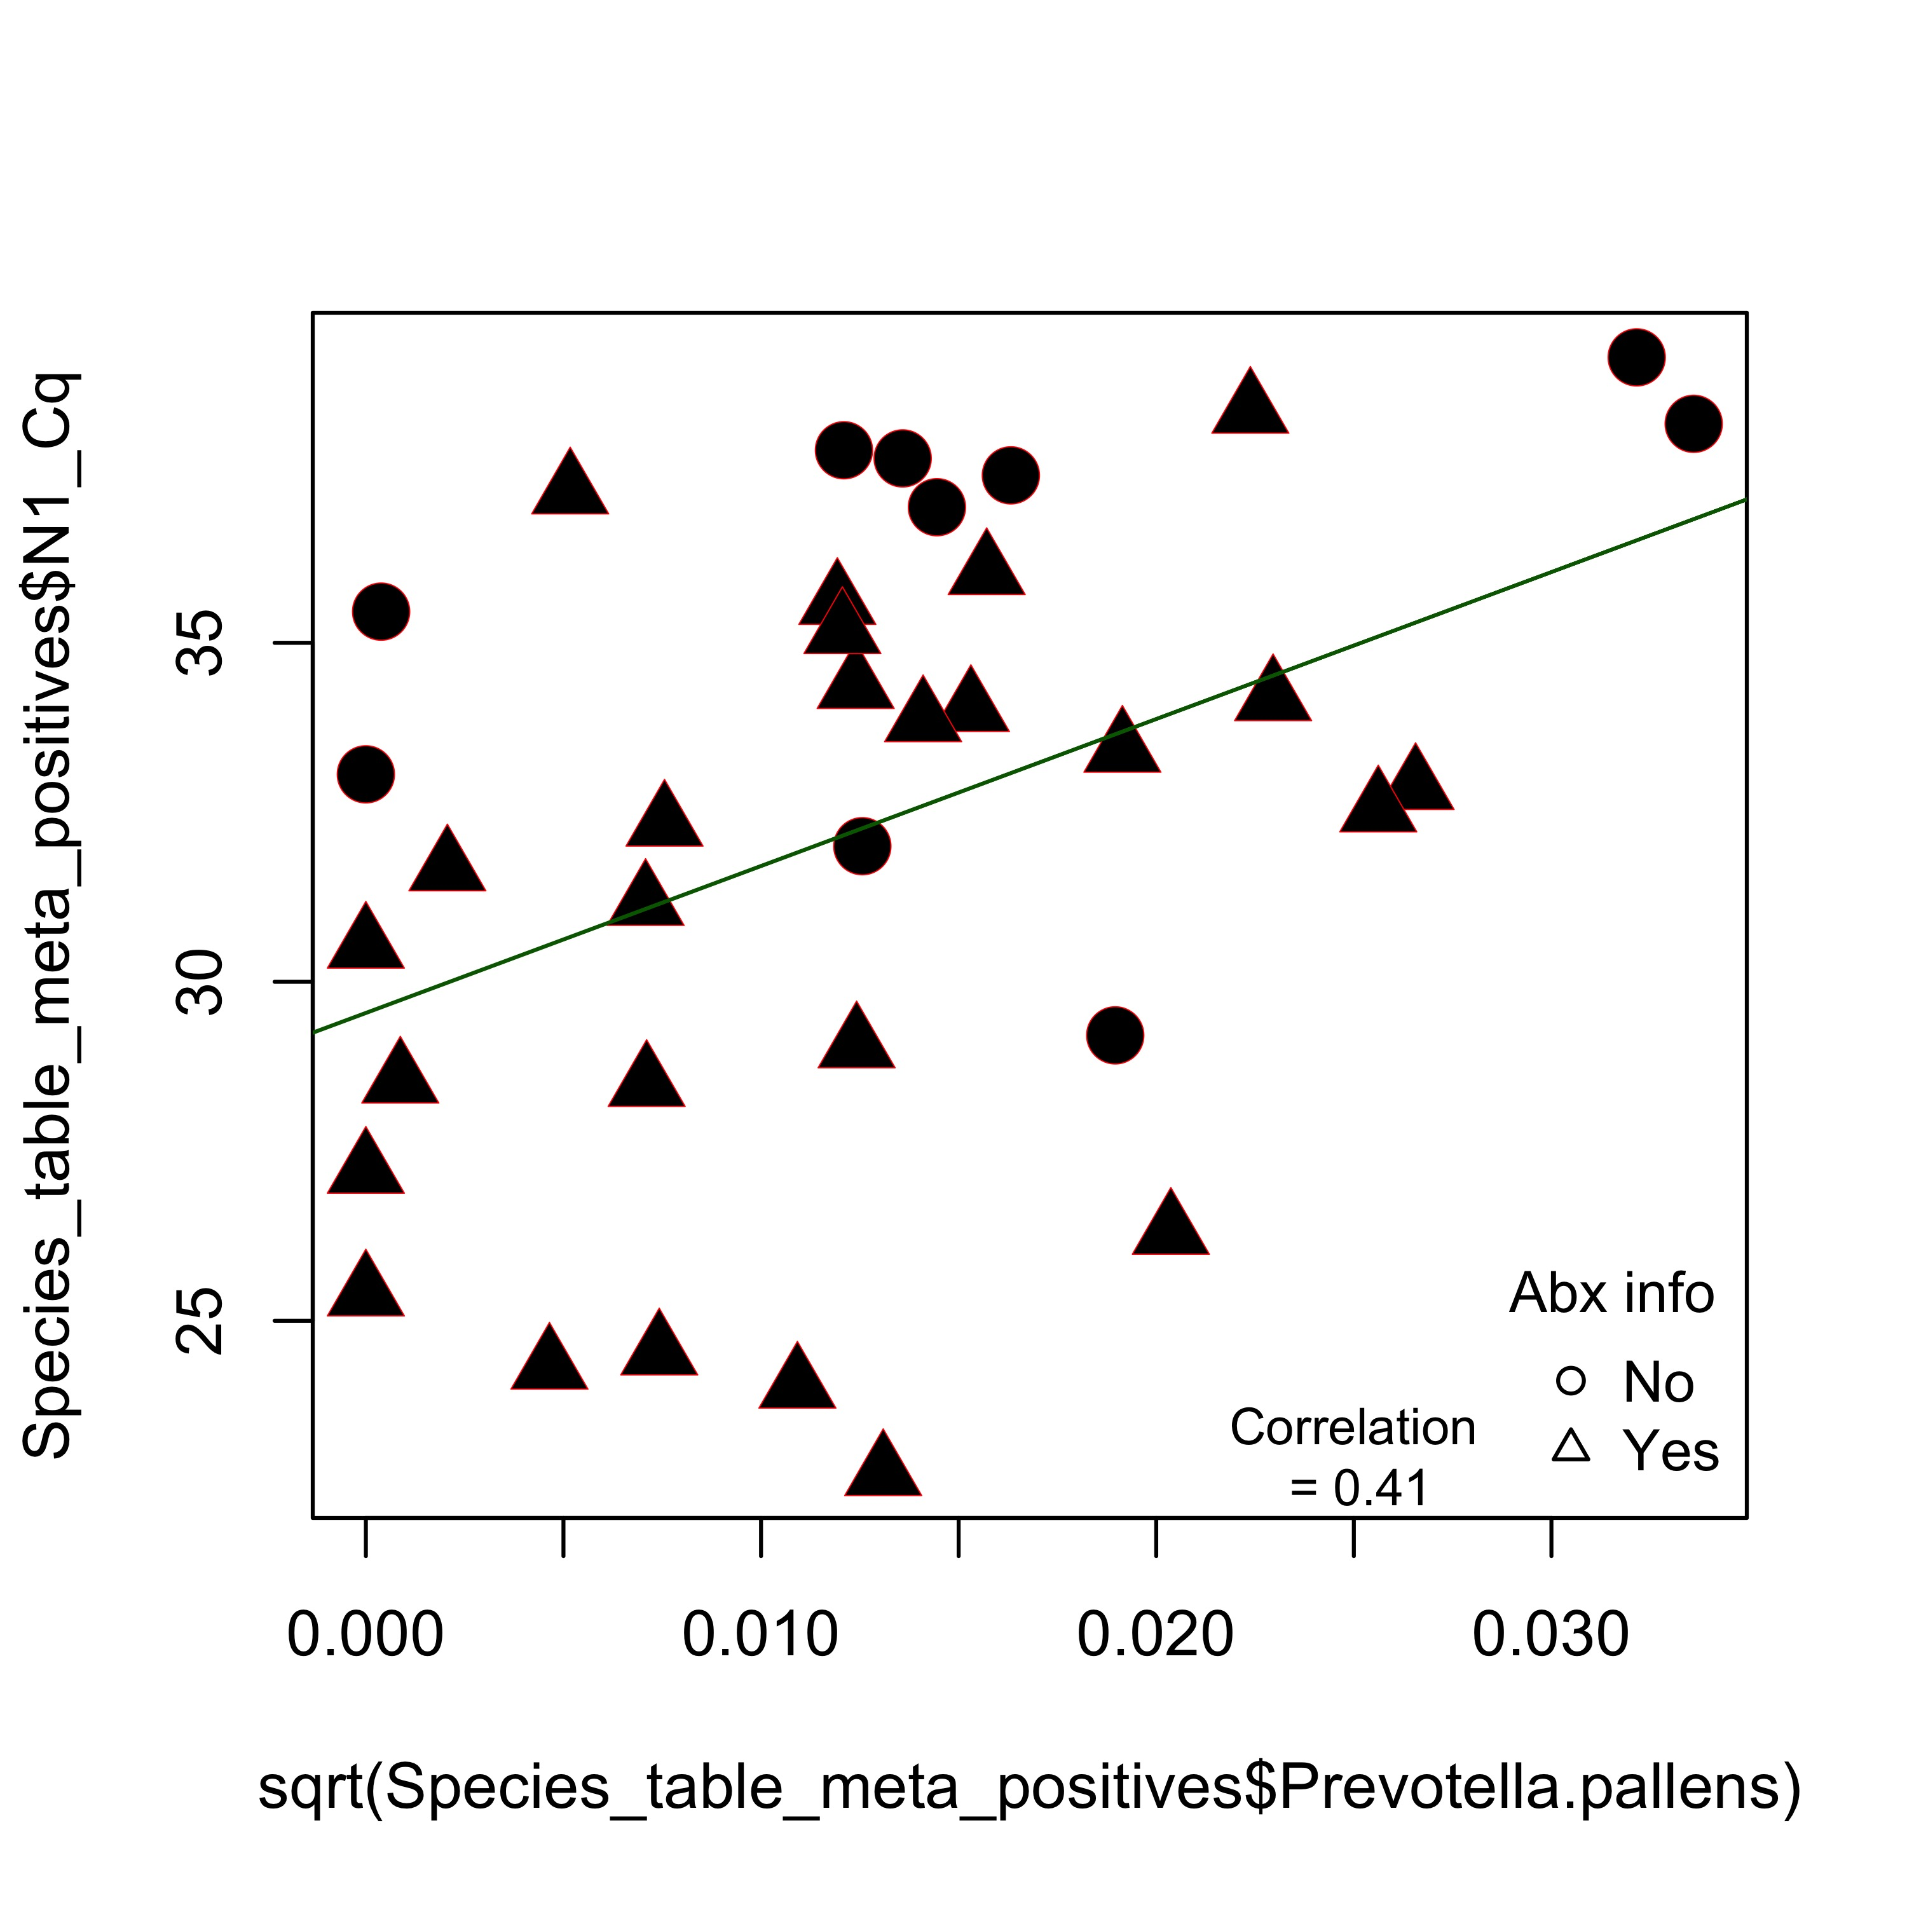
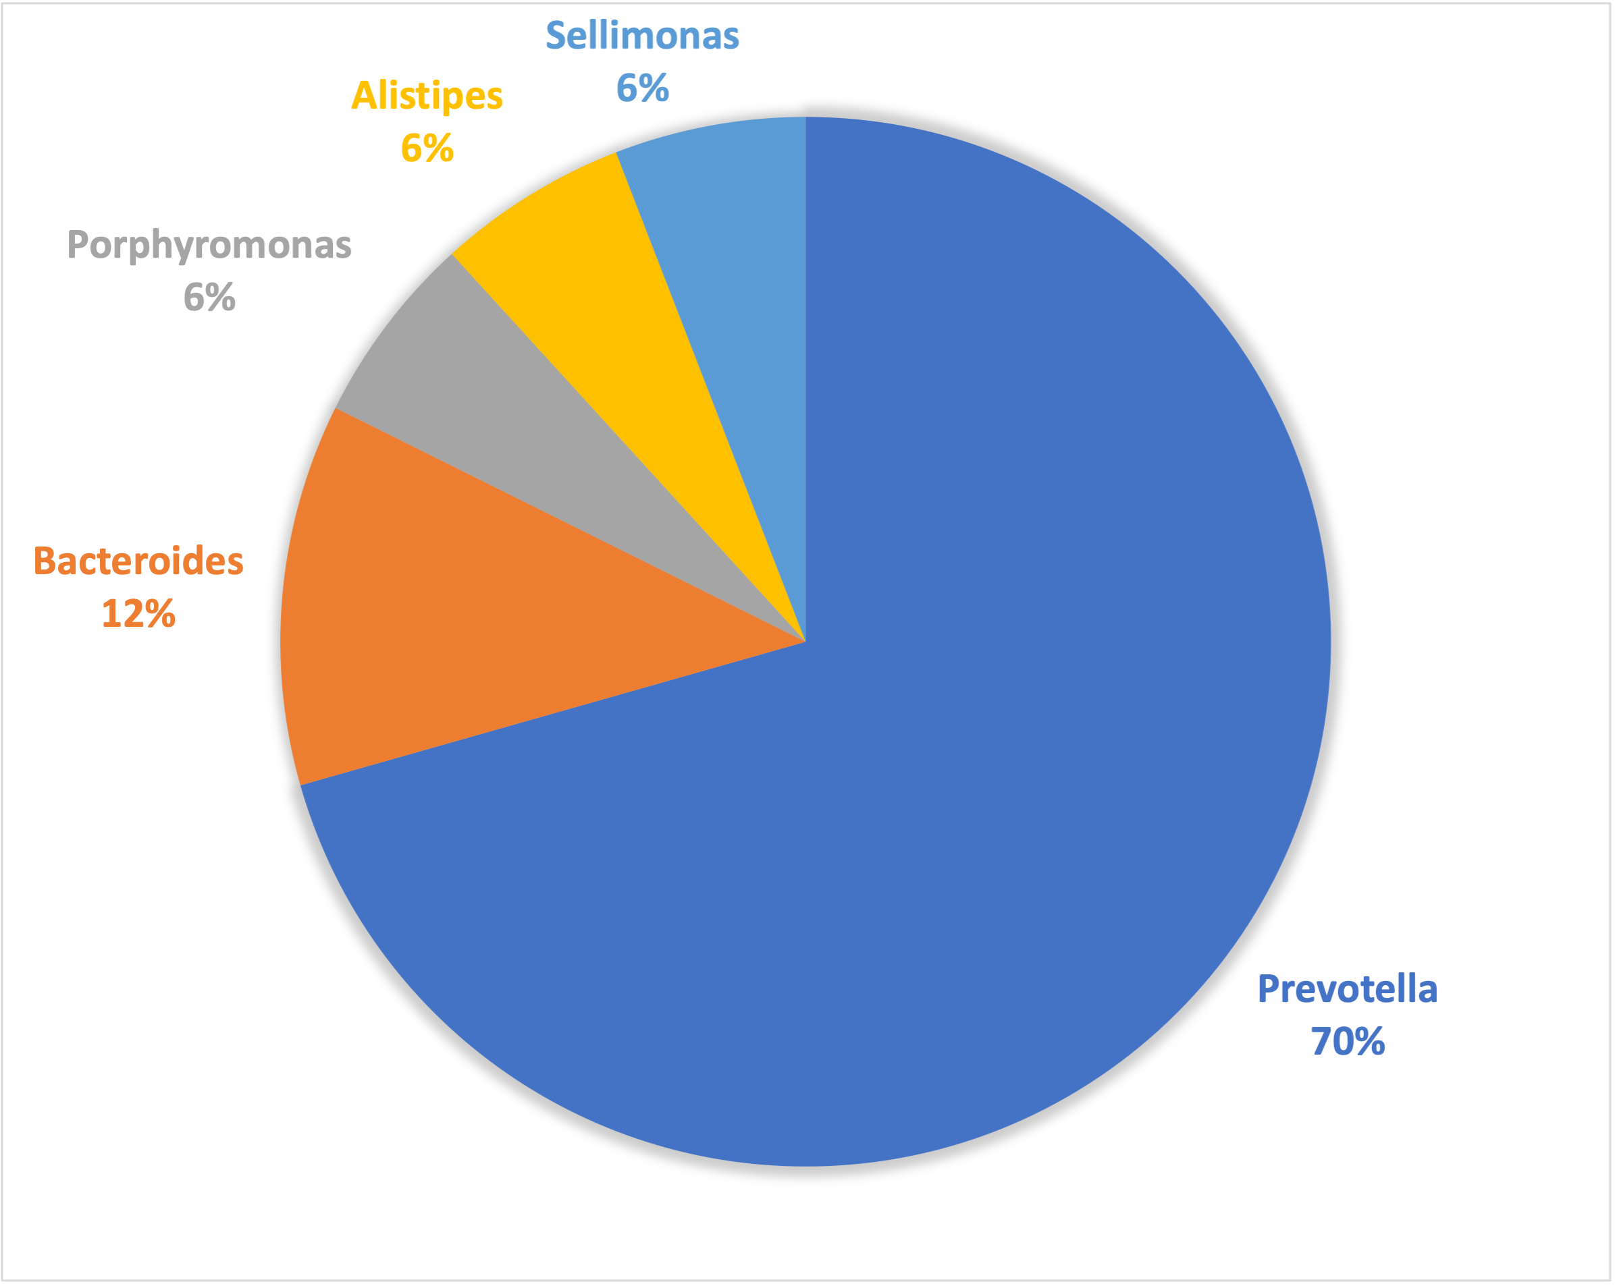
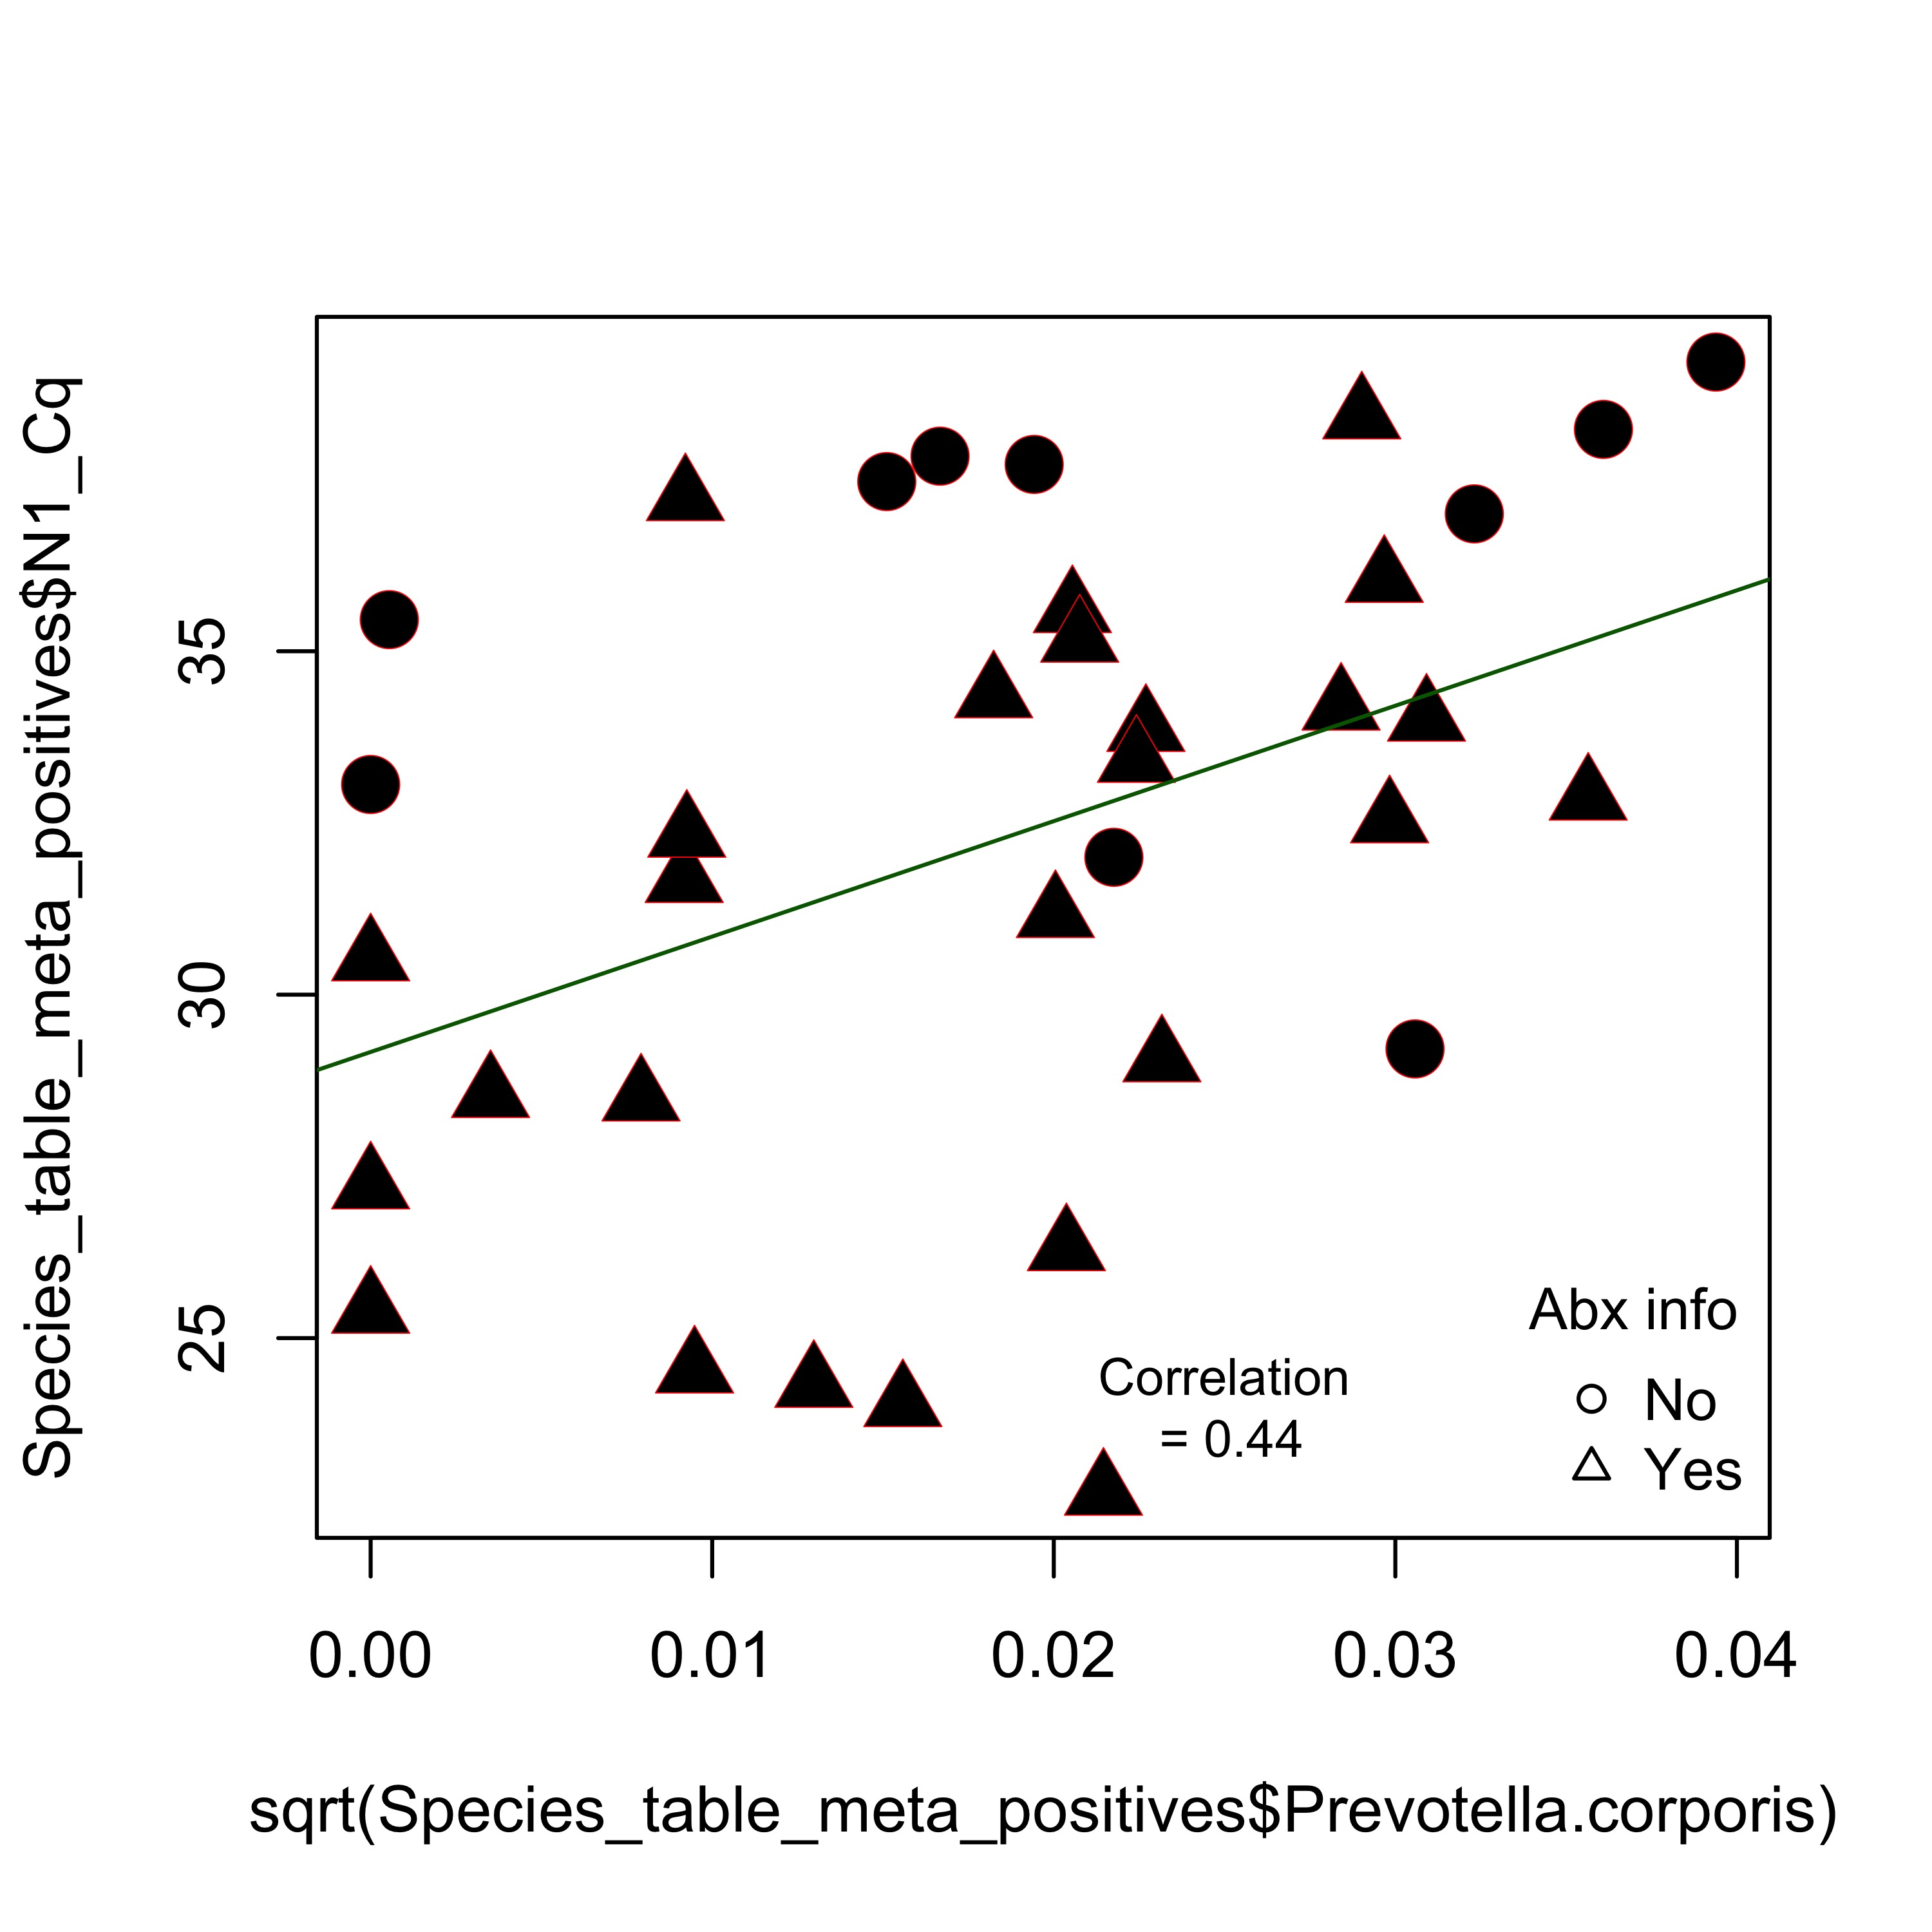
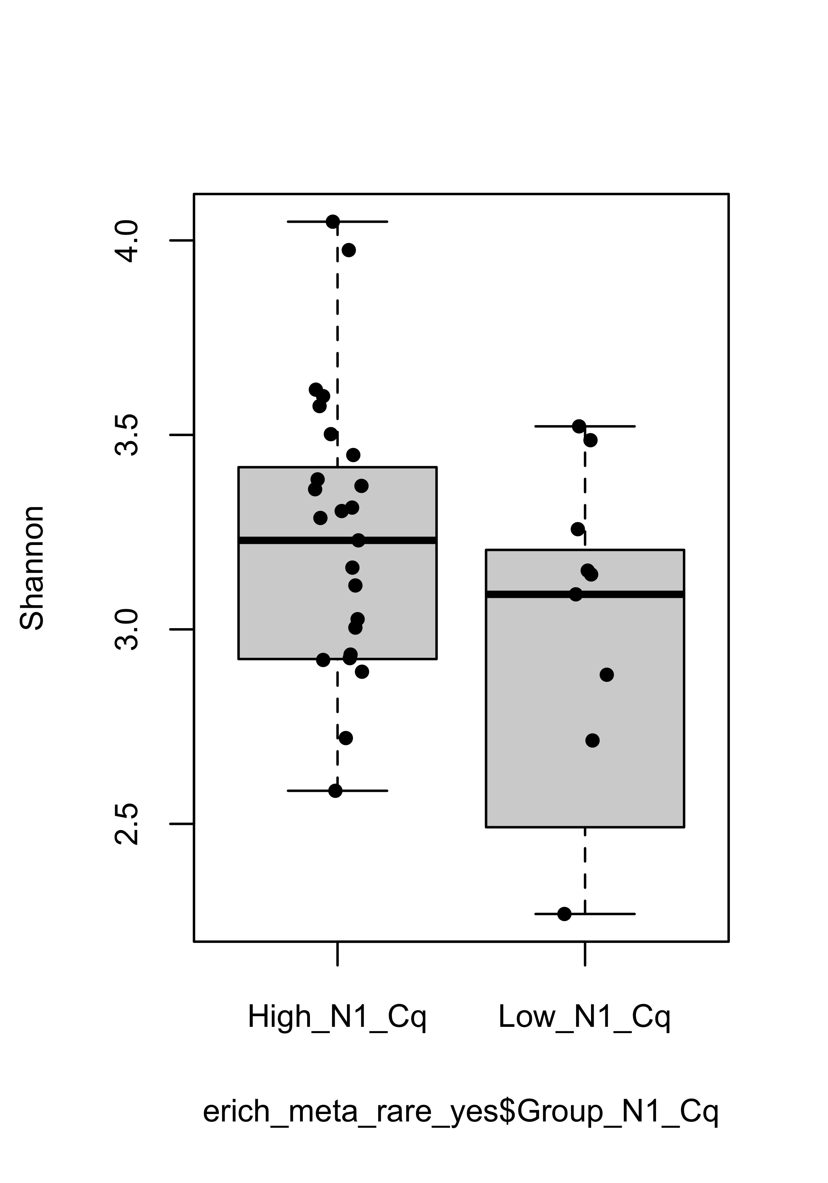
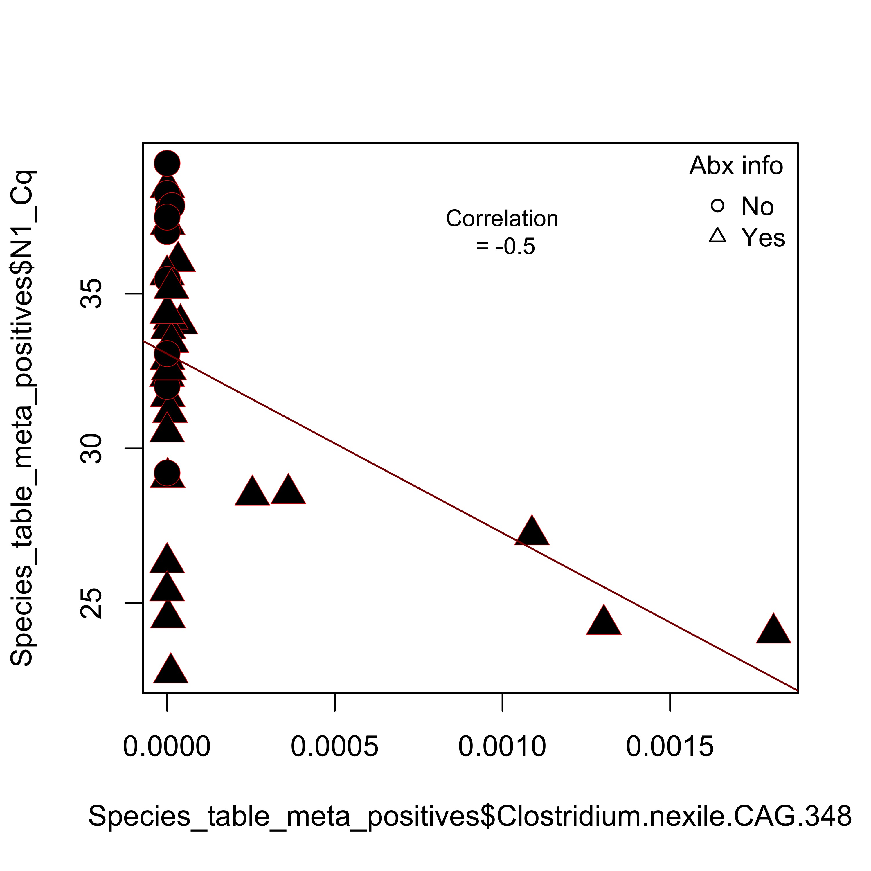
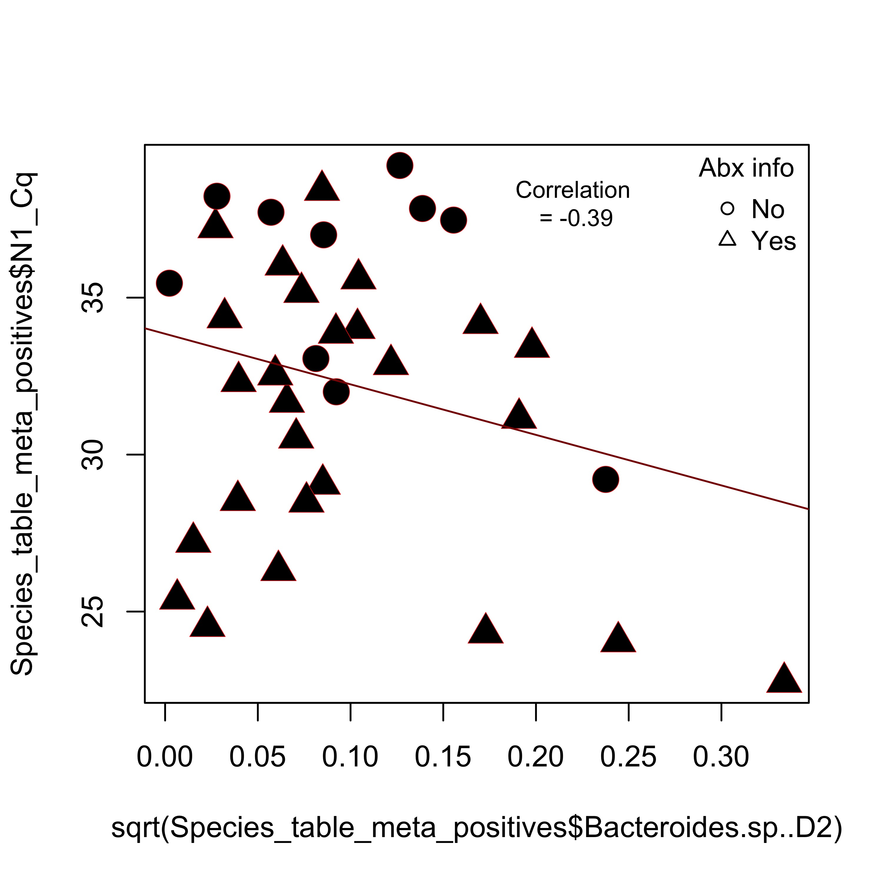
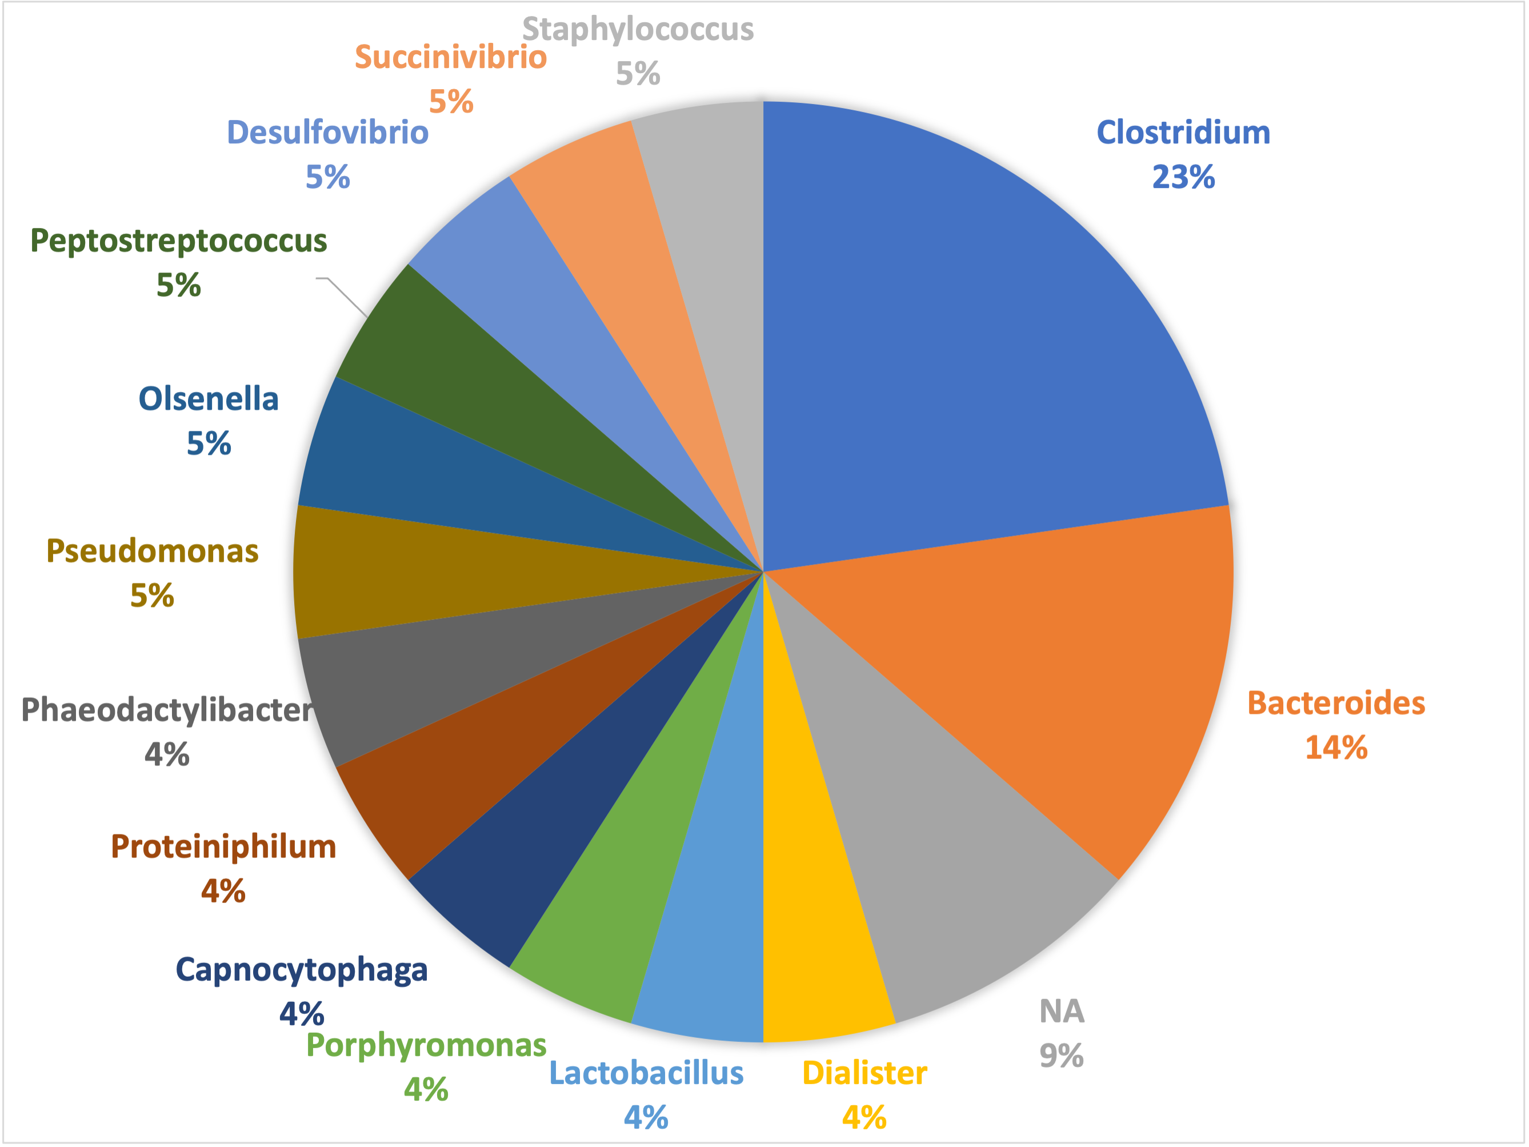
Higher microbial diversity and Prevotella enrichment associated with gut viral clearance
Prevotella enrichment and viral clearance
ns
Low viral load
Observed taxa
Prevotella corporis
Prevotella pallens
ns
Viral load (N1_Cq)
Shannon’s H
High viral load
Clostridium nexile CAG:348
Bacteroides sp. D2
Clostridium and Bacterioides enrichment and viral persistence

Slide 11
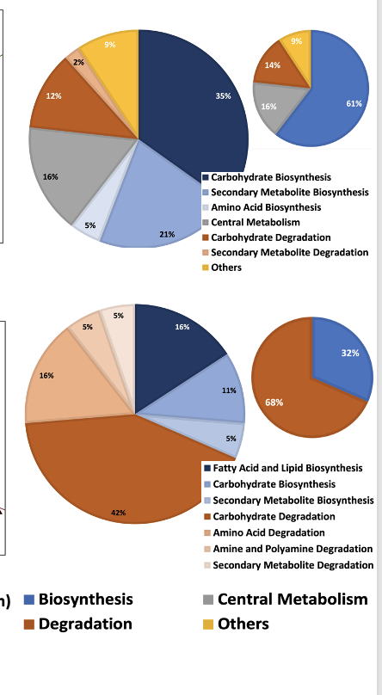
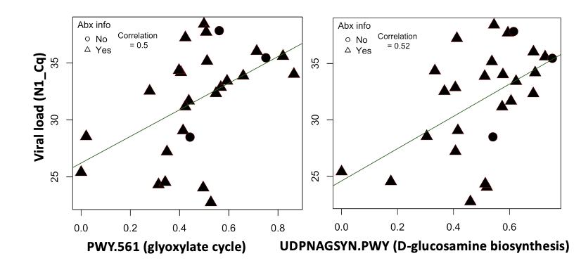
Microbial biosynthetic pathways are enriched in patients with low viral load
Low viral load
Pathway summary associated with Low viral load
Pathway summary associated with High viral load
High viral load
Notes:
Enriched “glyoxylate cycle” pathway may suggest that increased amount of succinate which can be used to produce short chain fatty acids, especially butyrate, in gut. Enriched glyoxylate cycle activities has been reported to ameliorate (treat) DSS-induced colitis inflammation (https://www.ncbi.nlm.nih.gov/pmc/articles/PMC7602078/)
Glucosamine biosynthesis: protection of Glucosamine (GlcN) against HFD-induced damage to colon tissues in mice; It is mainly responsible for maintaining the Integrity of colon tissue. Glucosamine also shows Inhibitory Effect on Inflammation in White Adipose Tissues and Blood (https://www.frontiersin.org/articles/10.3389/fphar.2021.694107/full)

Slide 12
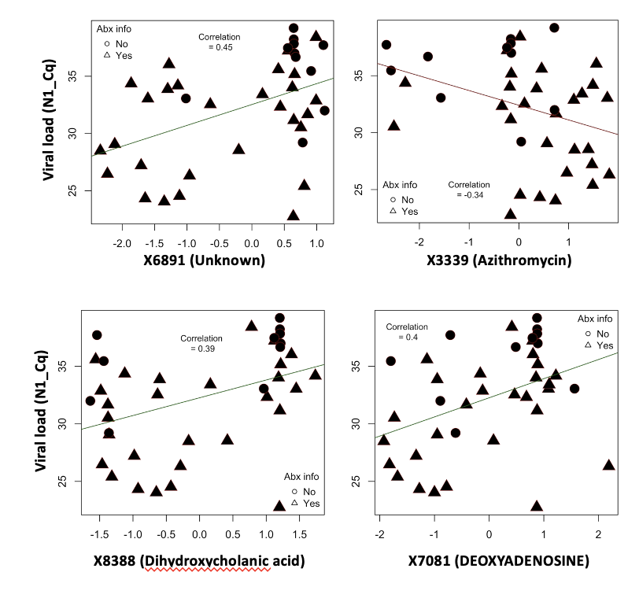
Enrichment of bile acid and purine metabolites is associated with gut viral clearance over time
Low viral load
Higher concentration of antibiotics such as Azithromycin and their derivatives associated with higher gut viral persistence
Higher concentration of other metabolites specifically metabolites involved in normal human metabolism associated with viral clearance
High viral load
Notes:
These observations specifically the involvement of Bile acid metabolism has been reported in Other studies also.

Slide 13
Summary
Microbial and metabolite features
Promotes SARS-CoV2 persistence
Promotes colonization resistance
Higher antibiotics usage
Clostridium and Bacteroides enrichment
Degradation pathways specifically degradation of simple polysaccharides
Higher intensity of antibiotics or their derivates
Low/No antibiotics
Prevotella enrichment
Biosynthetic pathways specifically synthesis of SCFAs and Glucosamine
Higher intensities of metabolites involved in bile acid and purine metabolism

Slide 14
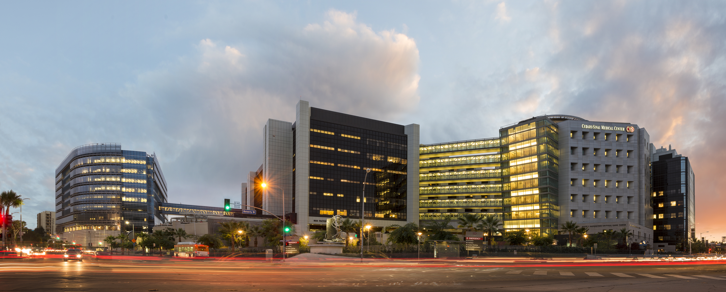
Acknowledgments
Cedars-Sinai
Suzanne Devkota, PhD David Underhill, PhD
Anthony Martin, PhD Kate Legree, PhD
Jacob Moskowitz, DVM/PhD Peter Chen, MD
Stephanie Bora, Ph.D
Univ of California-San Diego
Rob Knight, PhD
Pieter Dorrestein, PhD

